Slide 1


Slide 2
DEEP LEARNING COURSE
FALL 2024
Usman Khan, PhD

Slide 3
AIM
To introduce to the participants the latest advancements in Deep Learning technology.
Explore and discuss various cutting edge Deep Learning frameworks like various CNNs, GANs, NERFs, Transformers, Encoder Decoder Network

Slide 4
COURSE OUTLINE
Guideline | References
Textbook (or Laboratory Manual for Laboratory Courses) | Chollet, F. (2021). Deep learning with Python. Manning Publications, Han, J. et all. (2011). Data mining: Concepts and techniques (3rd ed.). Morgan Kaufmann Deep Learning for Computer Vision with Python. Adrian Rosebrock
Reference Material | https://machinelearningmastery.com Medium Articles and Other Research Papers on the Subject

Slide 5
COURSE OUTLINE
Week # | List of Topics
01 | Machine learning Concepts
02 | Features Engineering
03 | Neural Networks
04 | Advanced Model Performance & Evaluation Metrics
05 | Advanced Image Processing Techniques
06 | Deep Neural Networks Training Frameworks
07 | Convolutional Neural Networks Concepts
08 | Advanced CNN Concepts Like Pooling, Dropout, Concatenation, Merging
09 | MIDTERM EXAMINATION
10 | CNNs LeNet, VGG16
11 | Other Advanced CNNs like AlexNet, Residual Networks
12 | Advanced Transfer Learning Techniques
13 | Advanced Generative Adversarial Networks
14 | Advanced Conditional Generative Adversarial Networks
15 | Advanced Concepts like NERFs, Diffusion Nets, Attention Networks, Transformers
16 | TERMINAL EXAMINATION

Slide 6
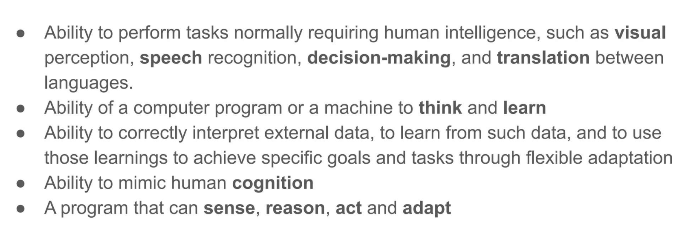
ARTIFICAL INTELLIGENCE

Slide 7
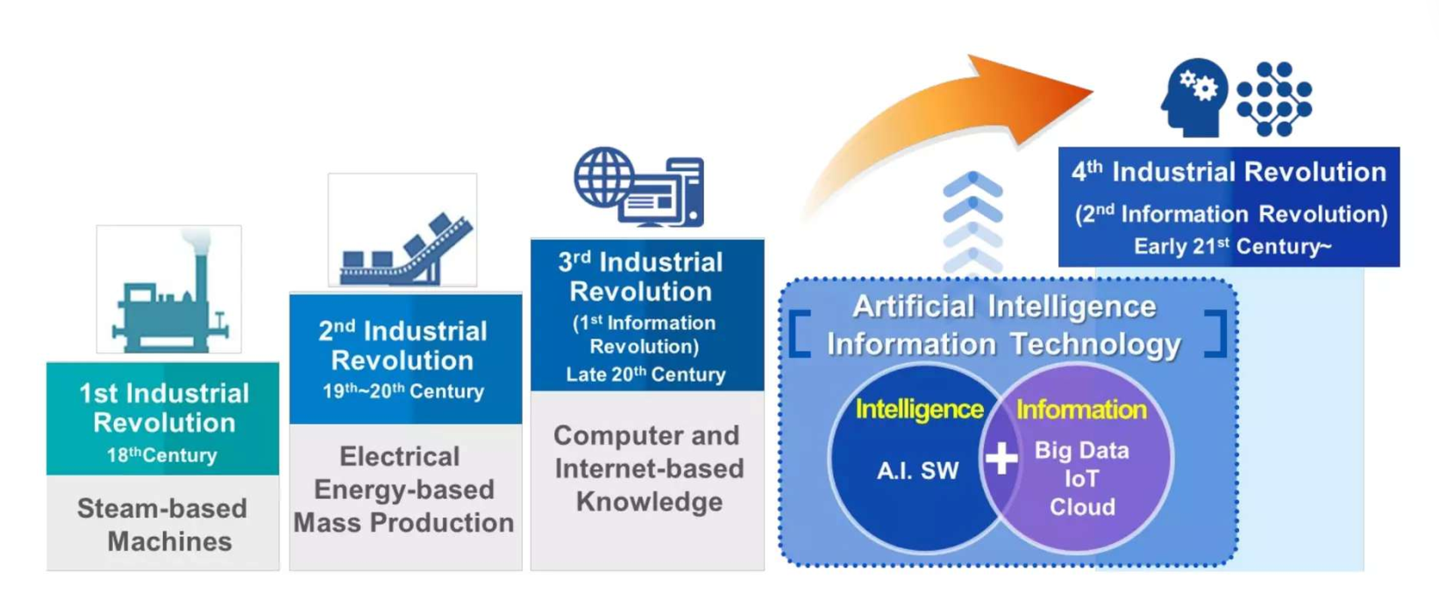
EVOLUTION OF INDUSTRY

Slide 8
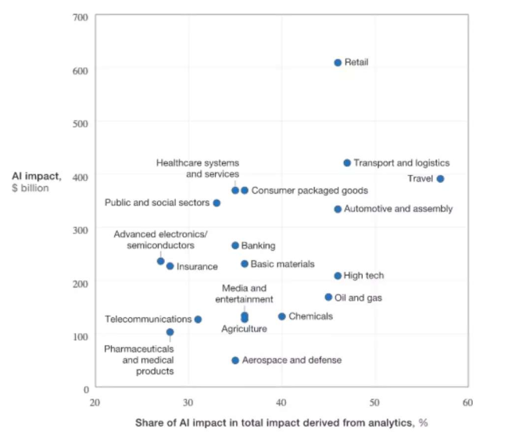
IMPACT OF AI

Slide 9
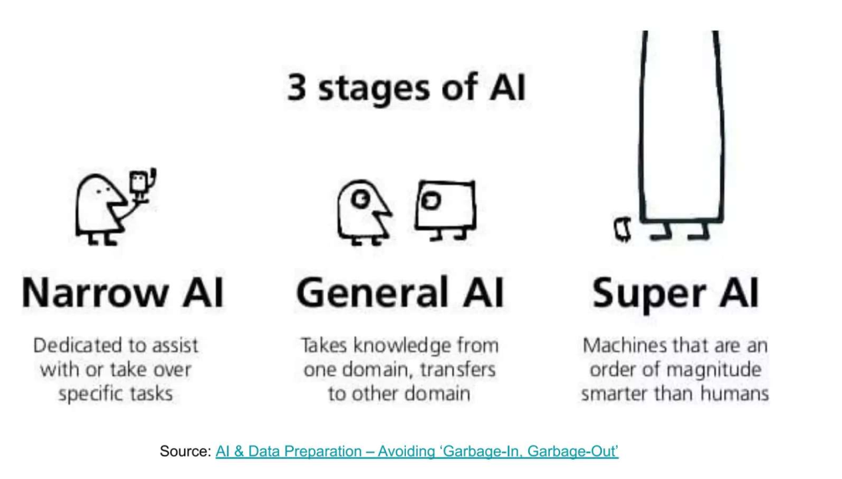
STAGES OF AI

Slide 10
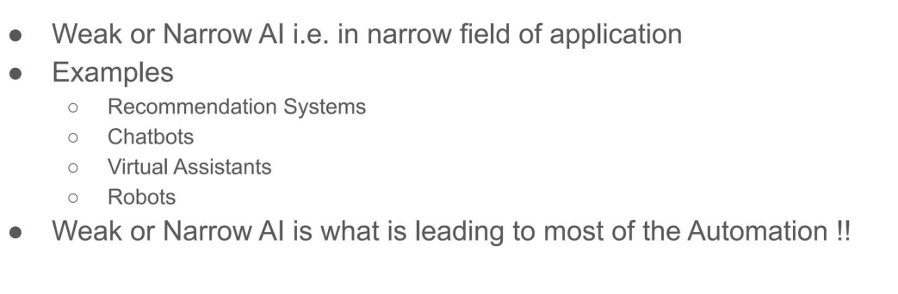
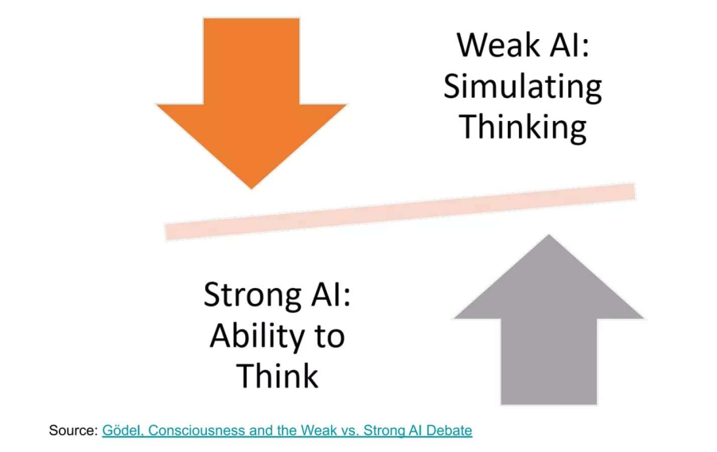
STRONG VS WEAK AI

Slide 11
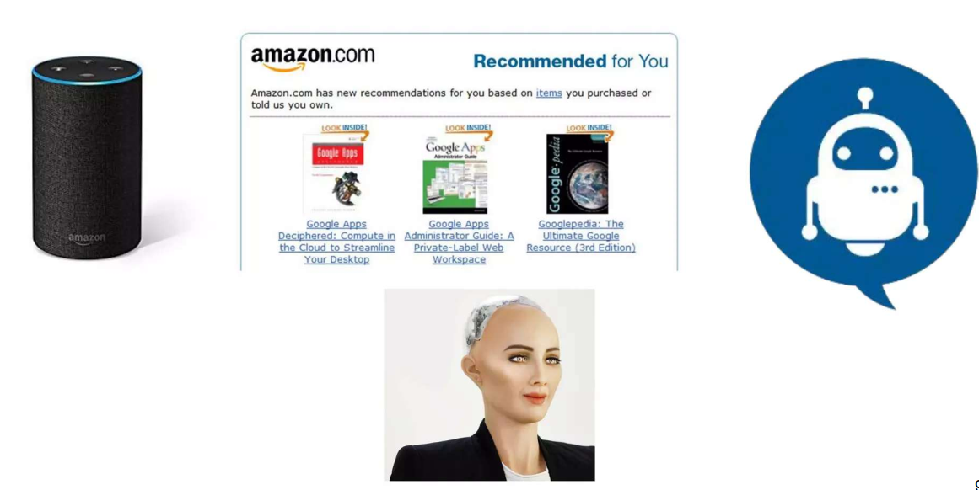
AI THAT WE ENCOUNTER

Slide 12
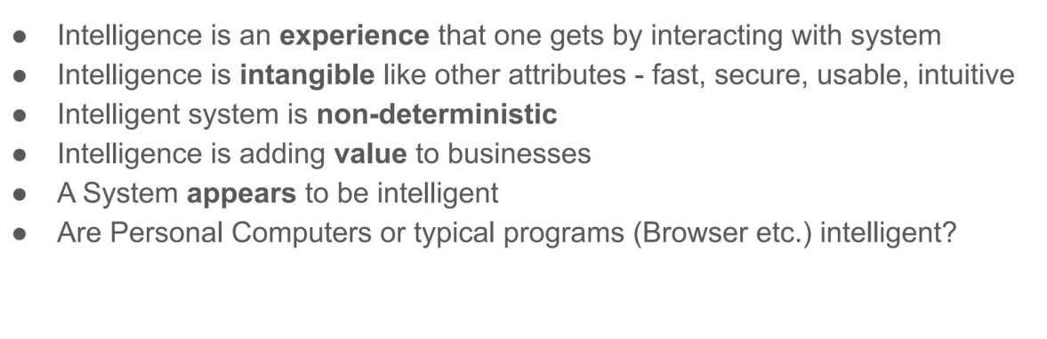
INTELLIGENT SYSTEM

Slide 13
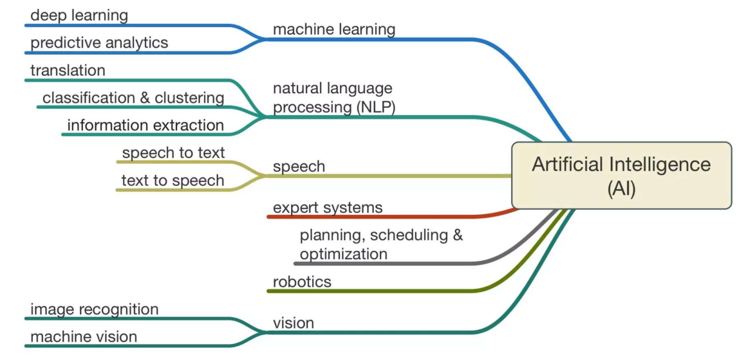
ARTIFICIAL INTELLIGENCE SCOPE

Slide 14
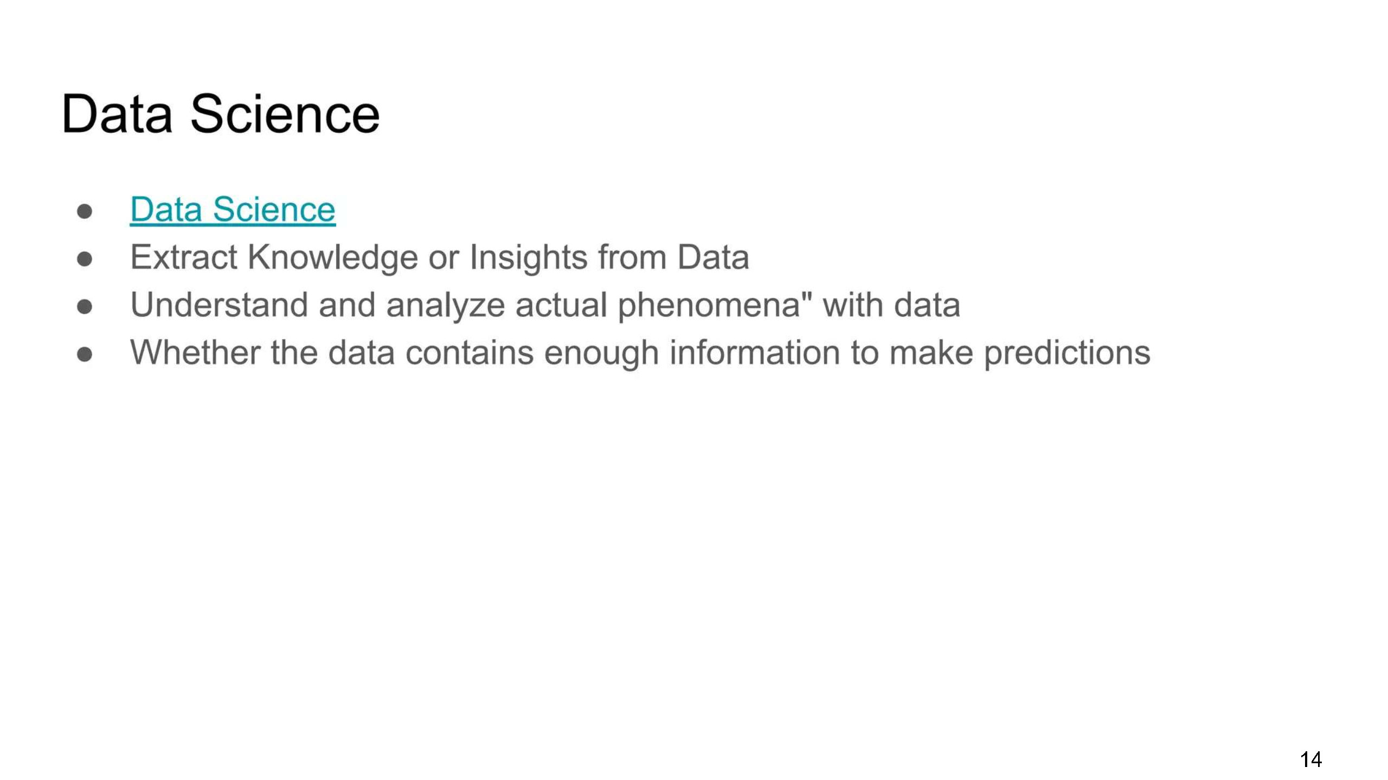
DATA SCIENCE

Slide 15
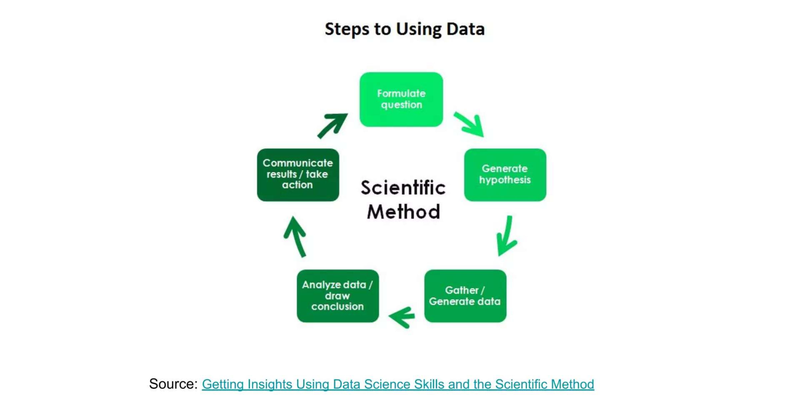
STEPS TO USE THE DATA

Slide 16
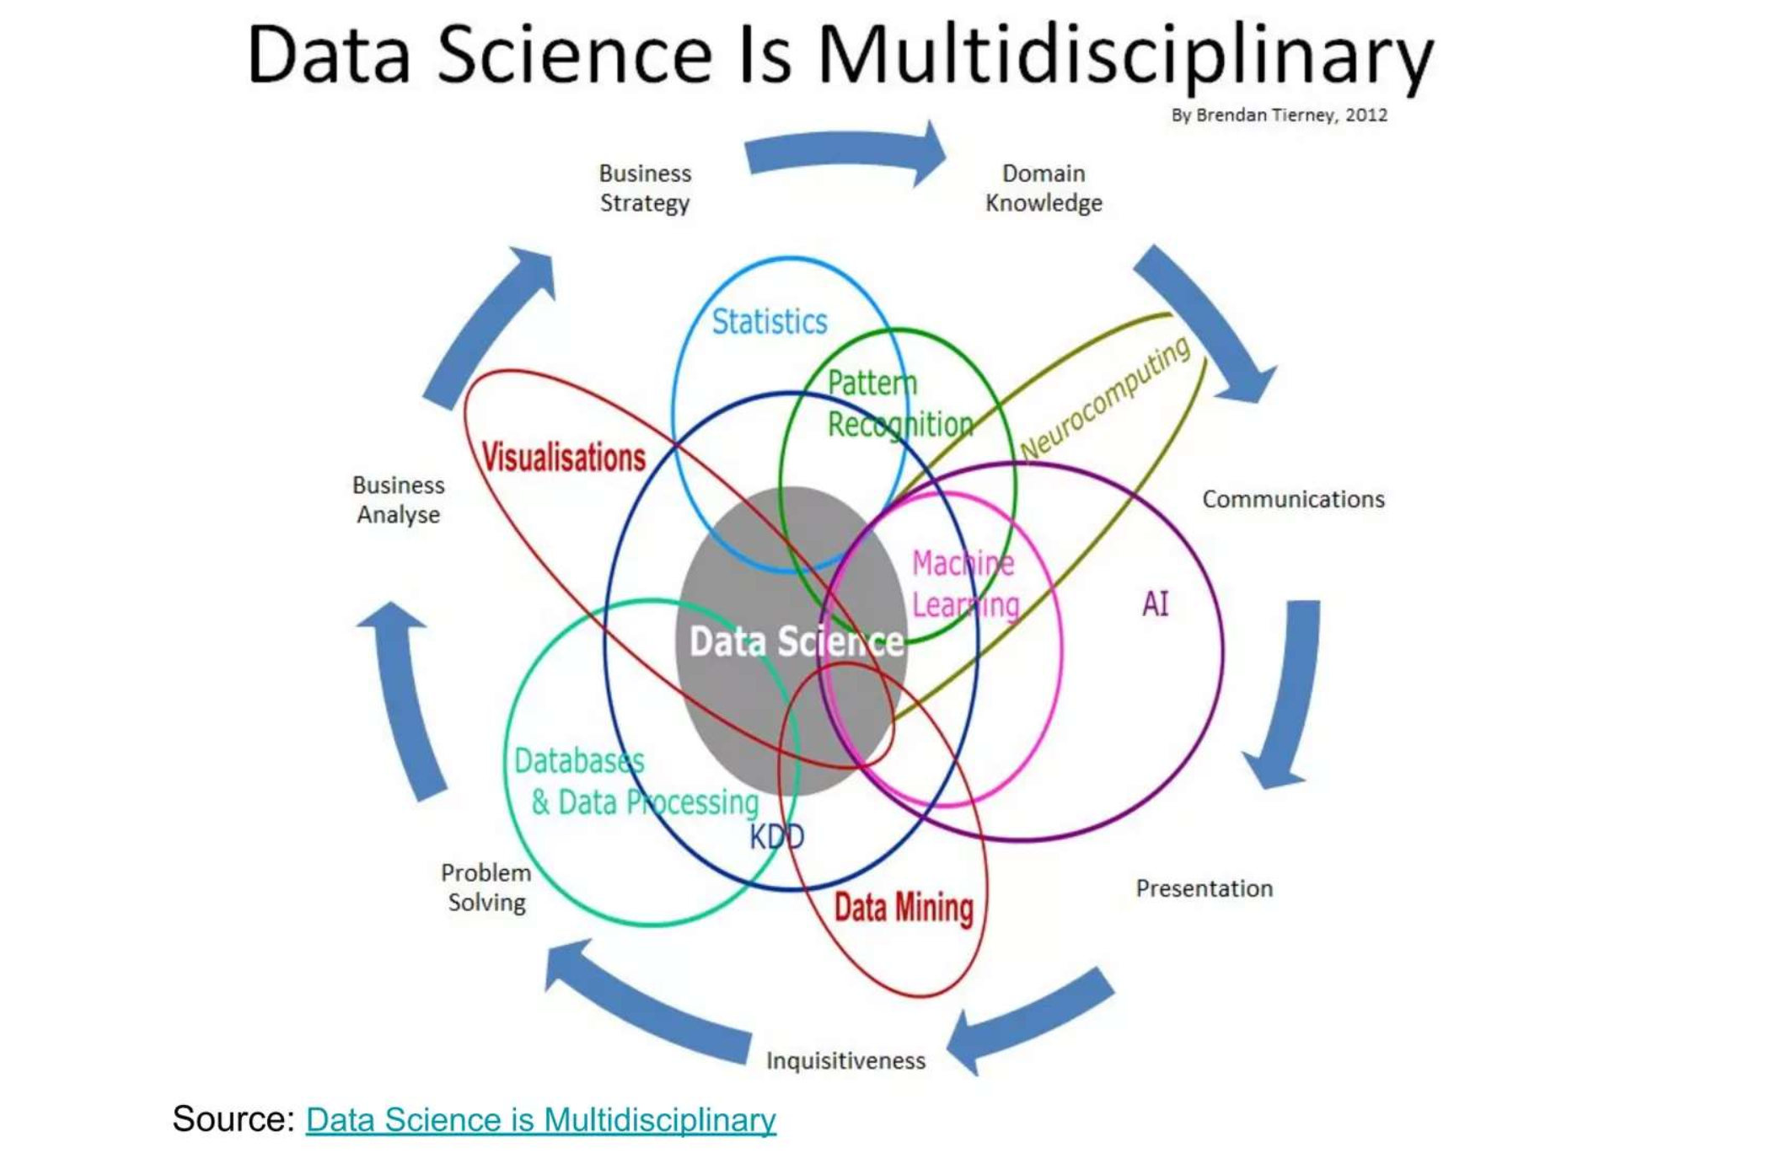
STEPS TO USE THE DATA

Slide 17
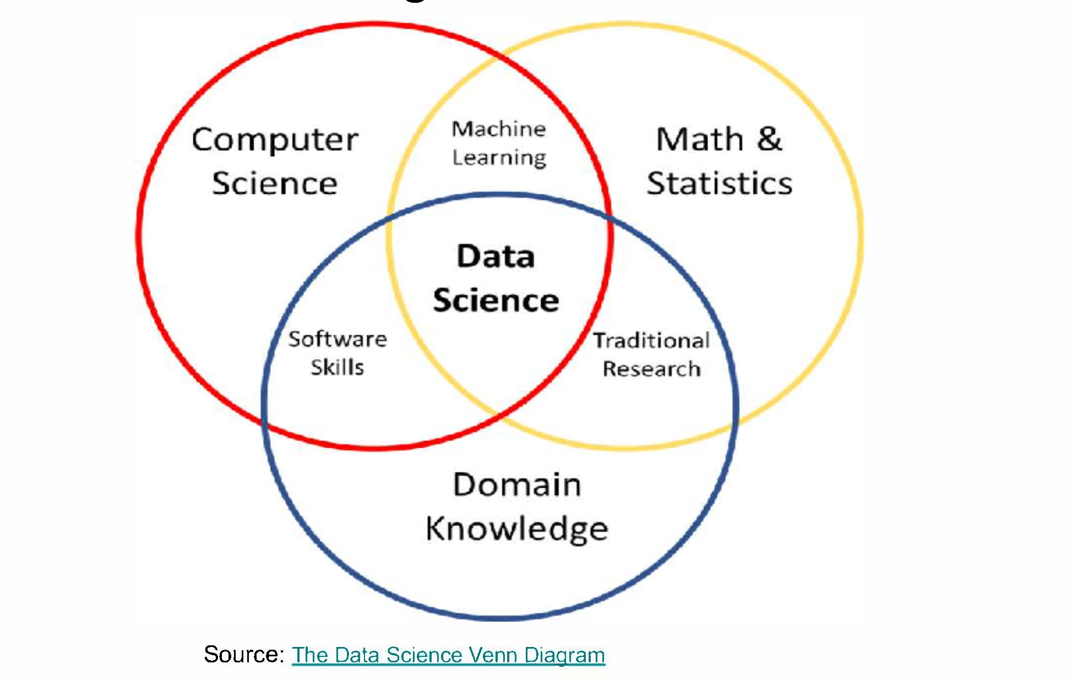
STEPS TO USE THE DATA

Slide 18
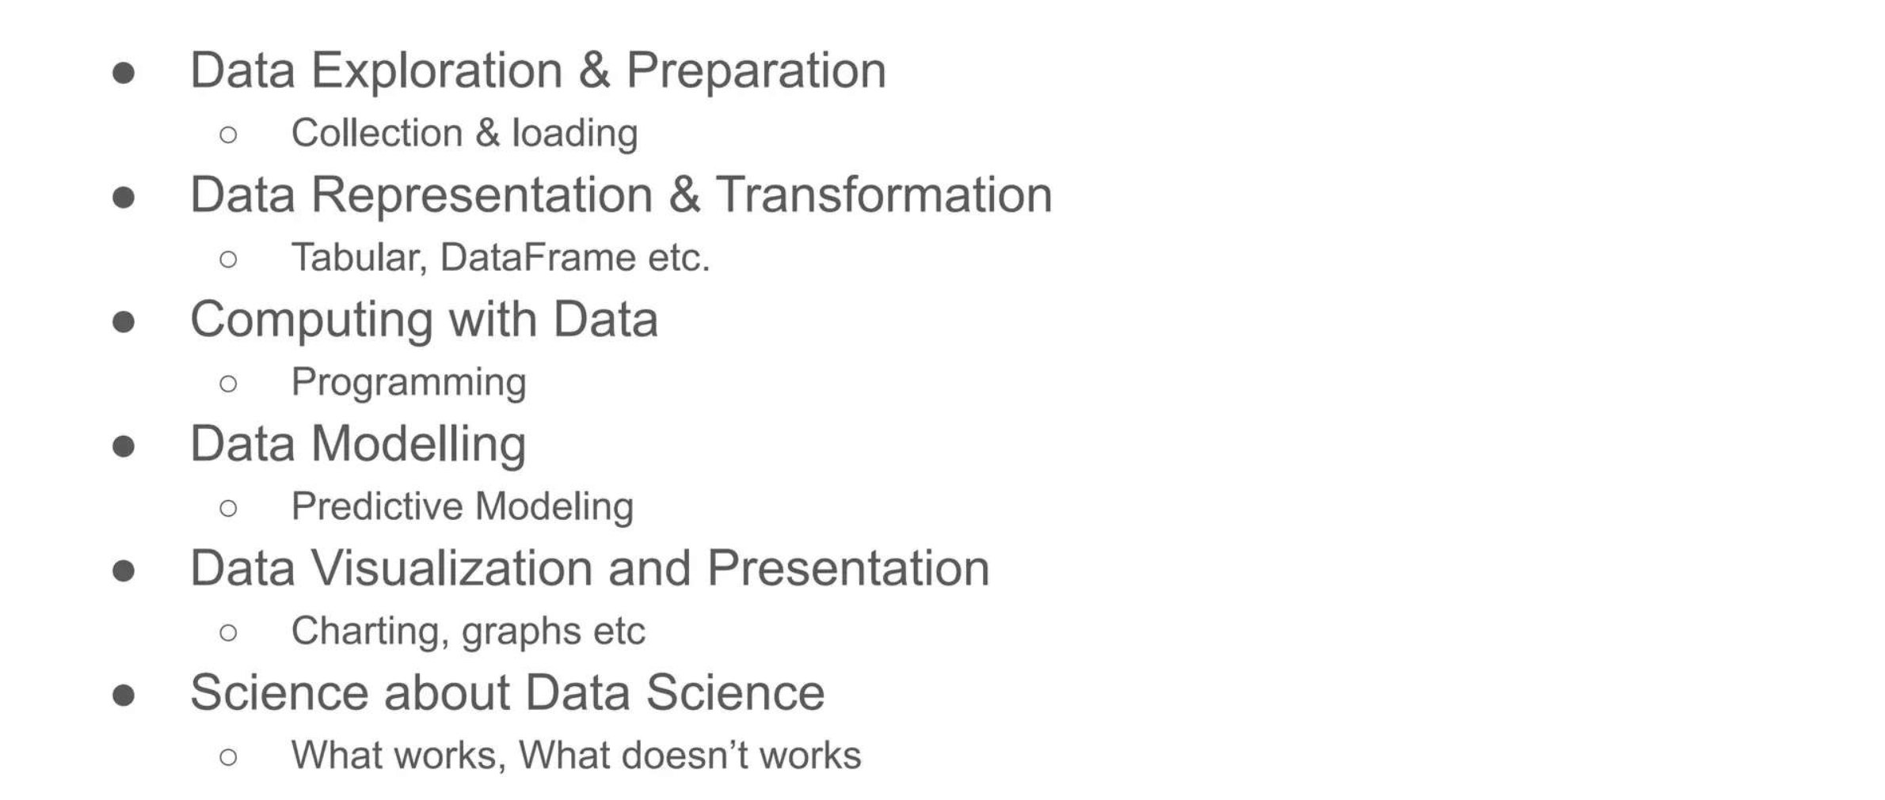
ACTIVITIES IN DATA SCIENCE

Slide 19
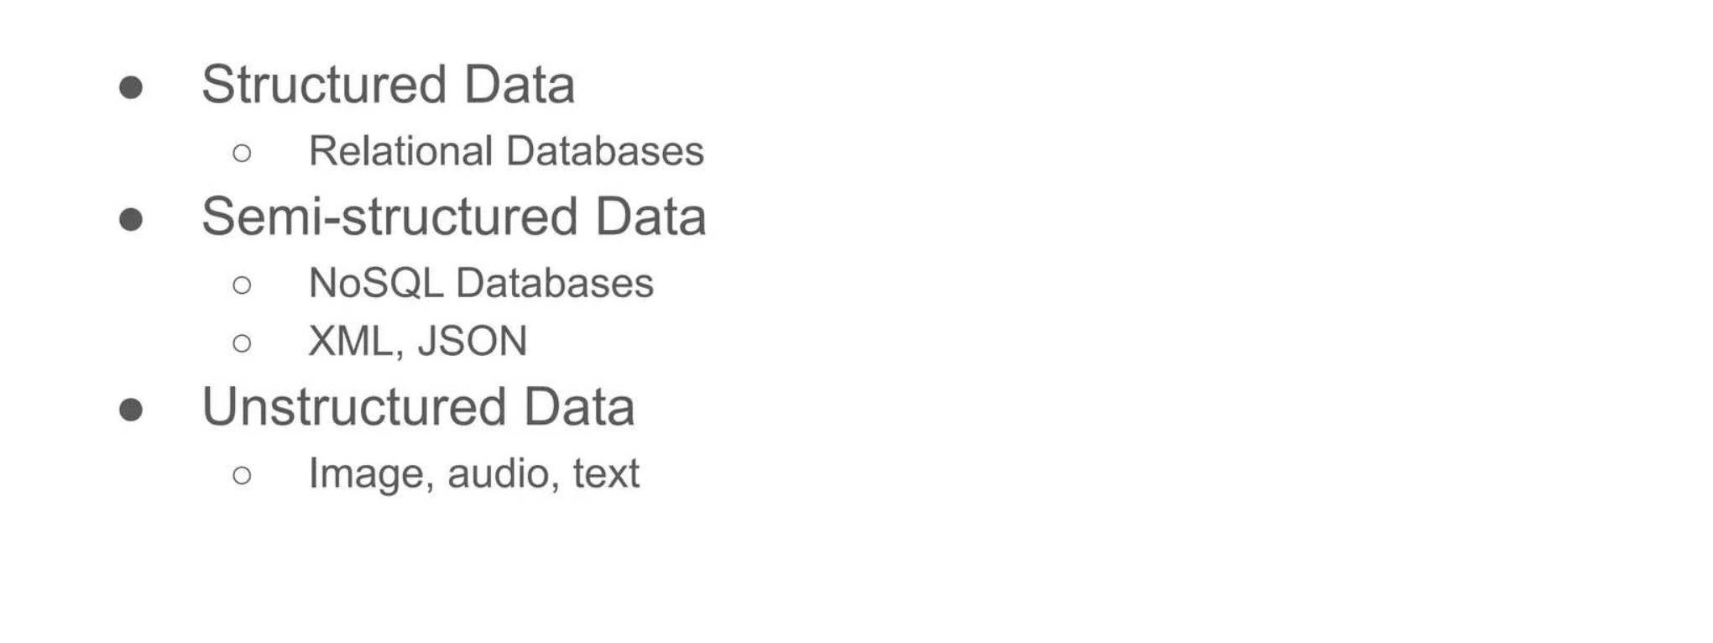
WHAT ARE DIFFERENT TYPES OF DATA ?

Slide 20
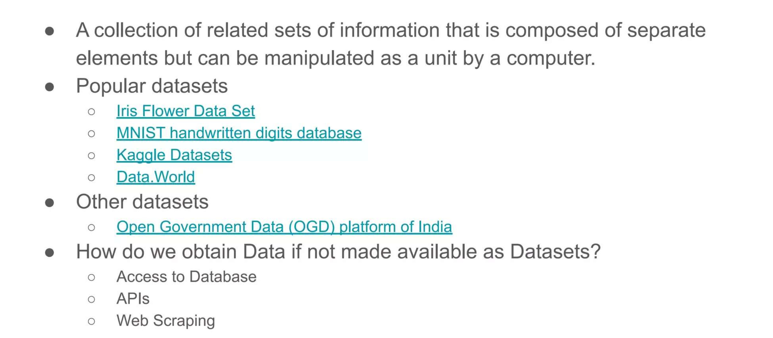
WHAT IS DATASET

Slide 21
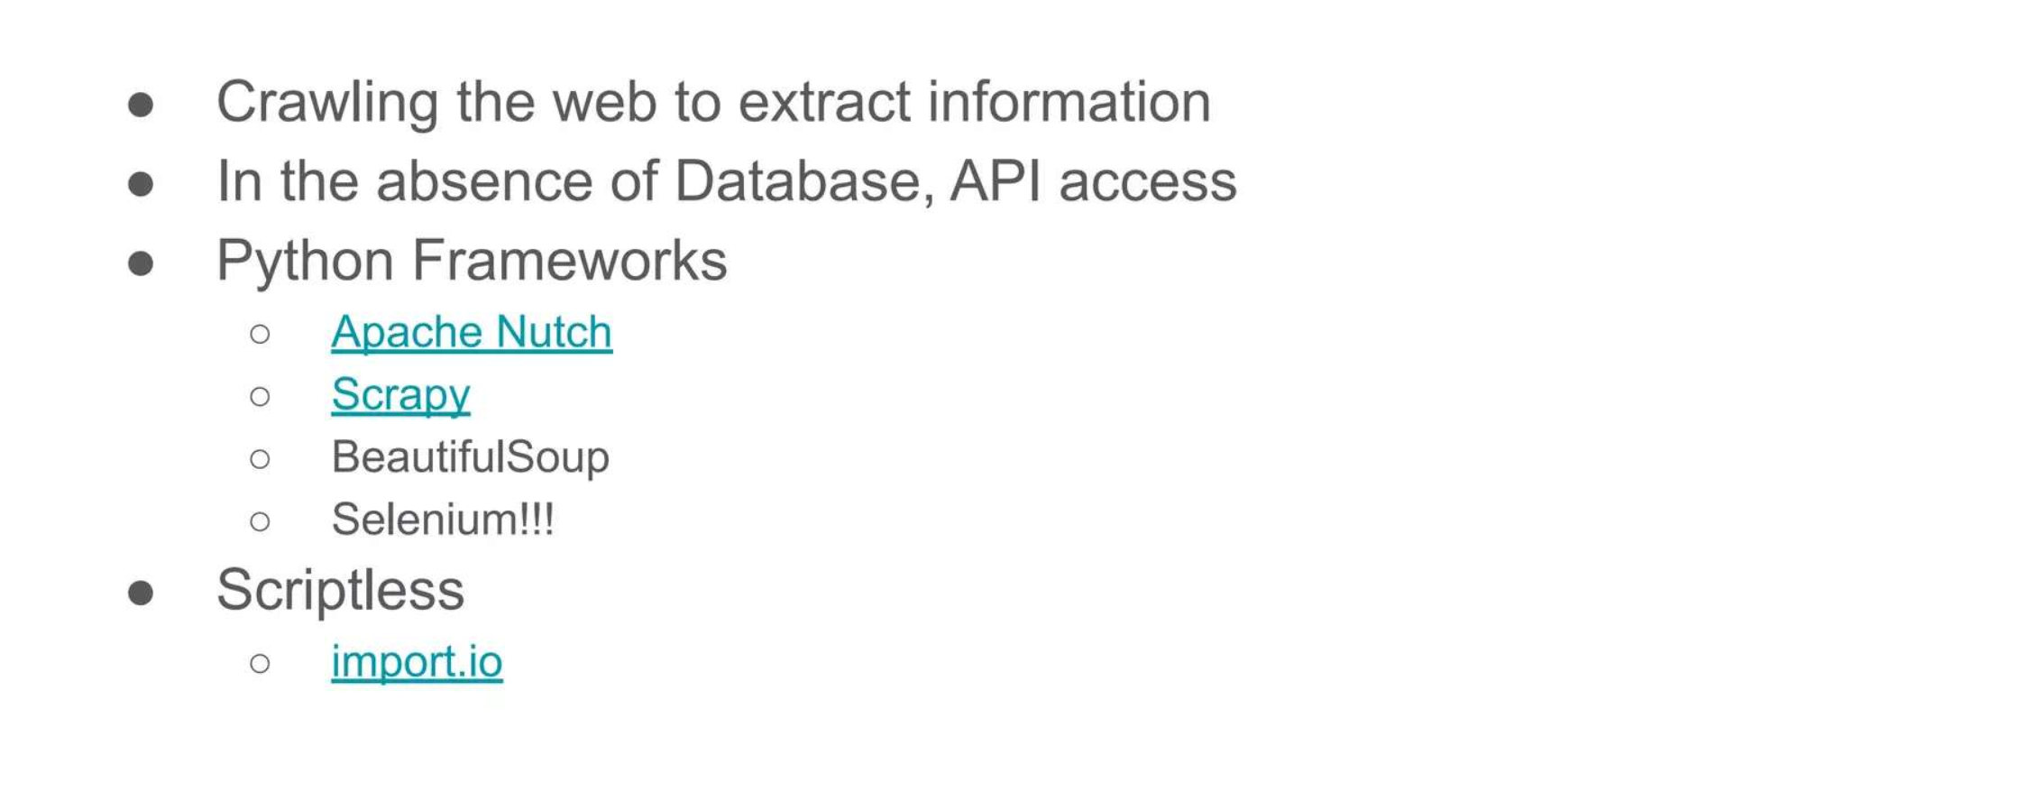
WEB SCRAPING

Slide 22
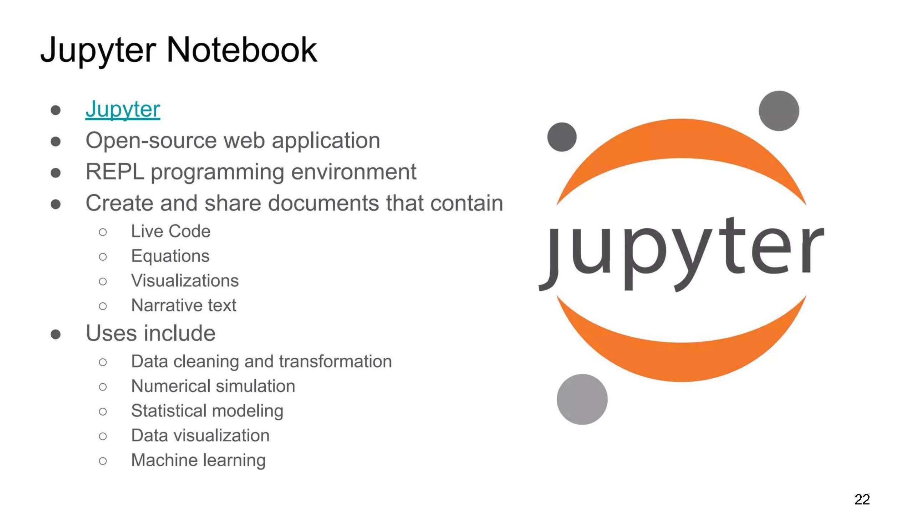
WEB SCRAPING

Slide 23
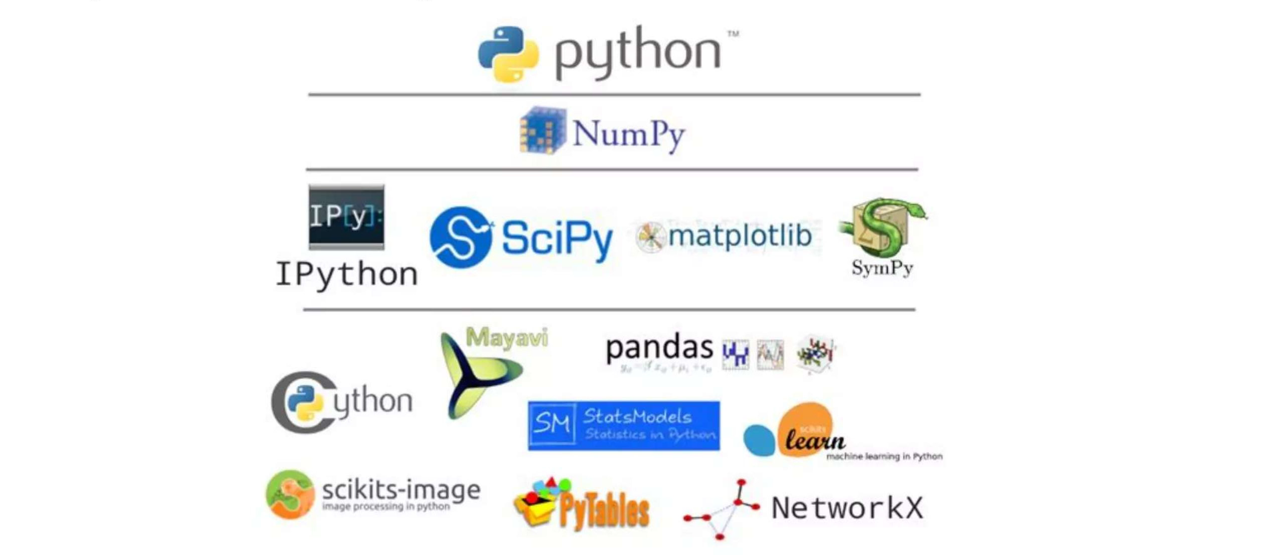
PYTHON ECO SYSTEM

Slide 24
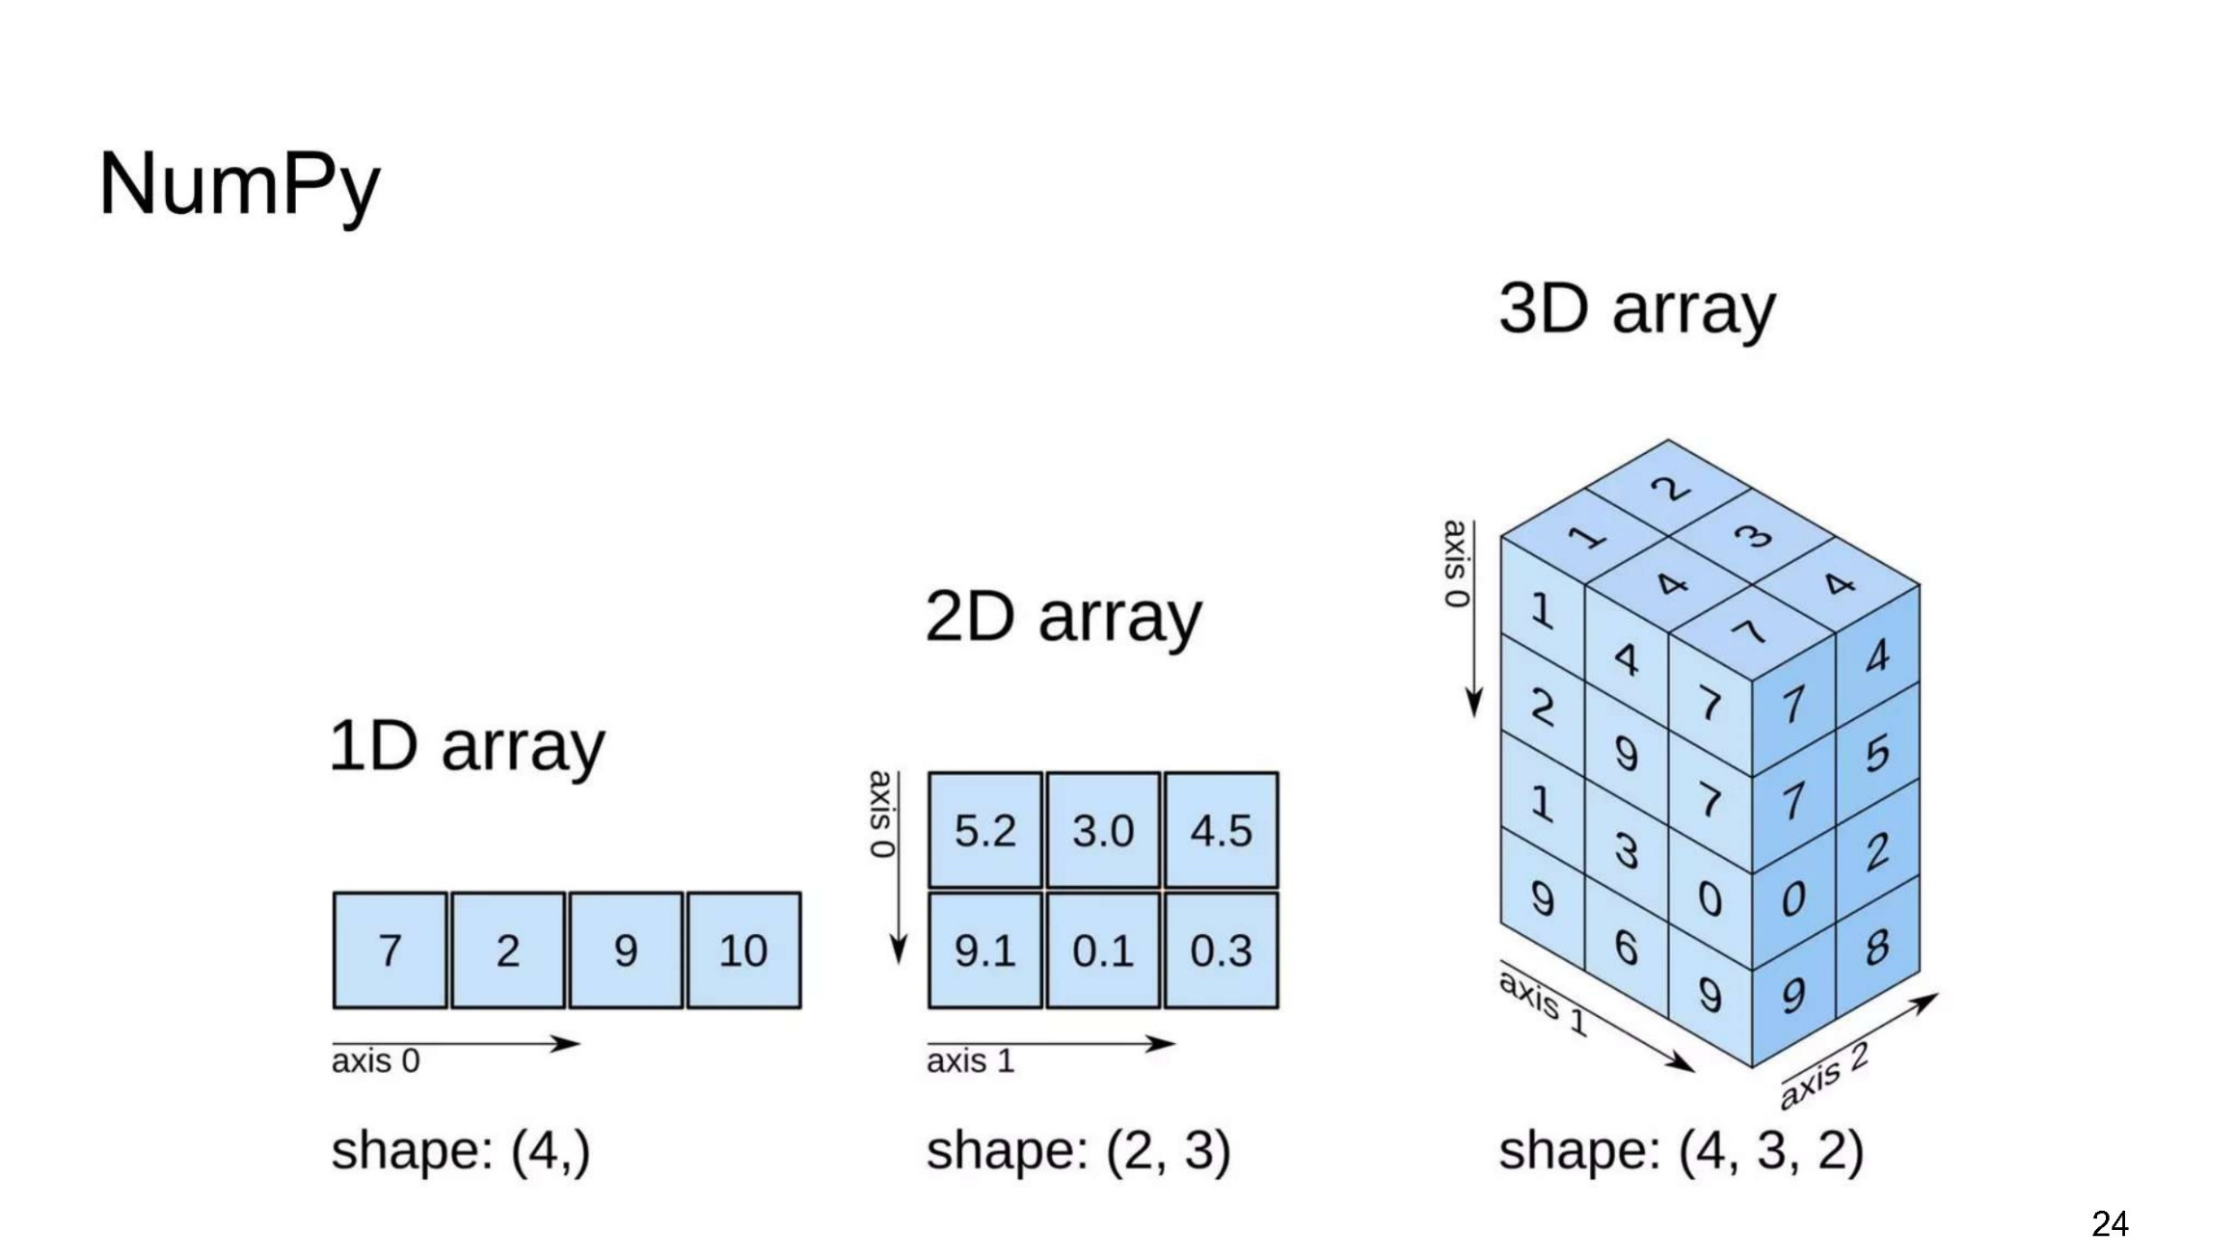
PYTHON ECO SYSTEM

Slide 25
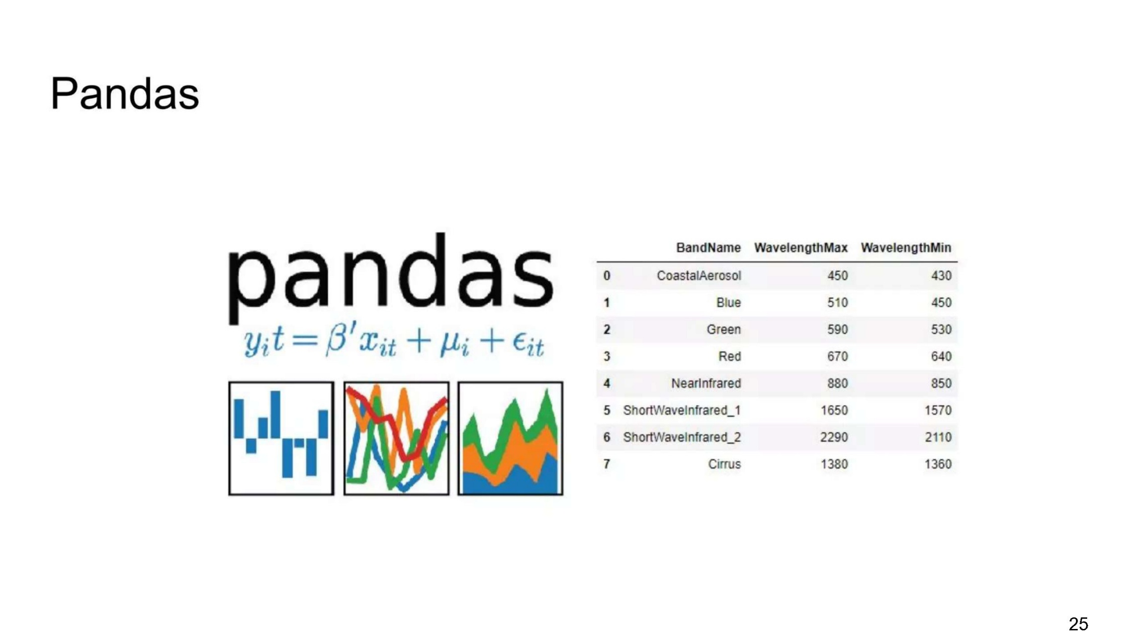
PYTHON ECO SYSTEM

Slide 26
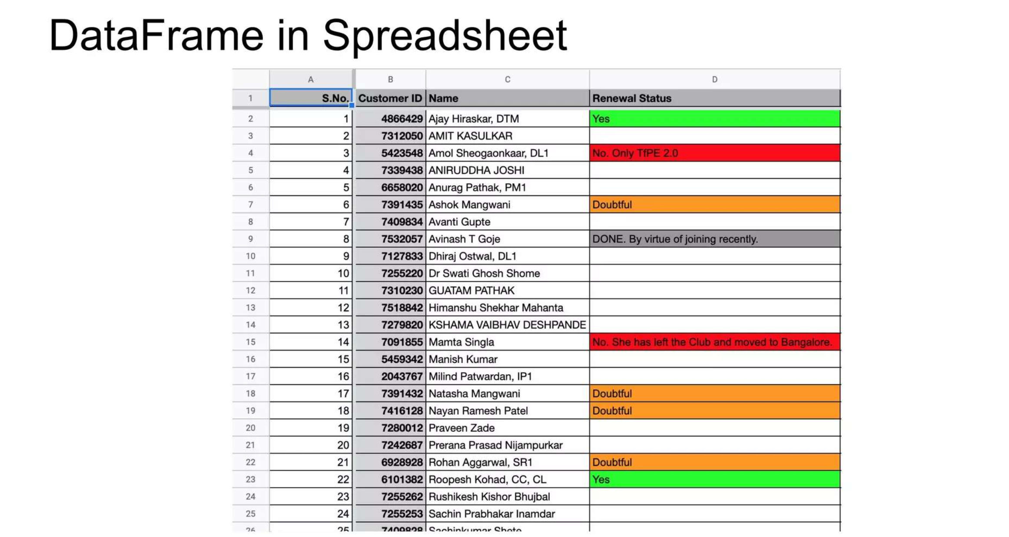
PYTHON ECO SYSTEM

Slide 27
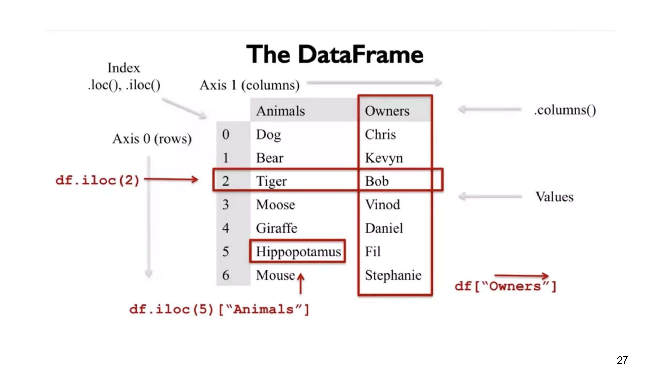
PYTHON ECO SYSTEM

Slide 28
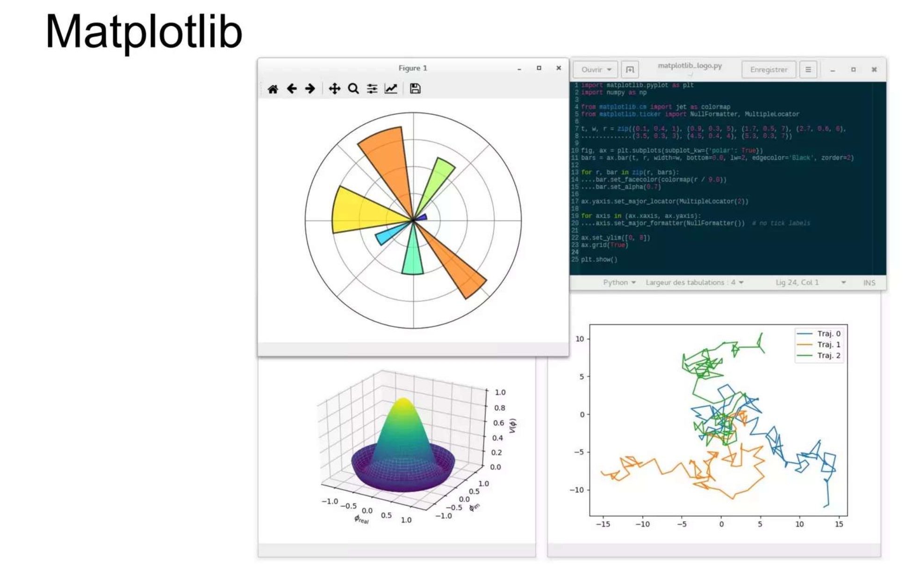
PYTHON ECO SYSTEM

Slide 29
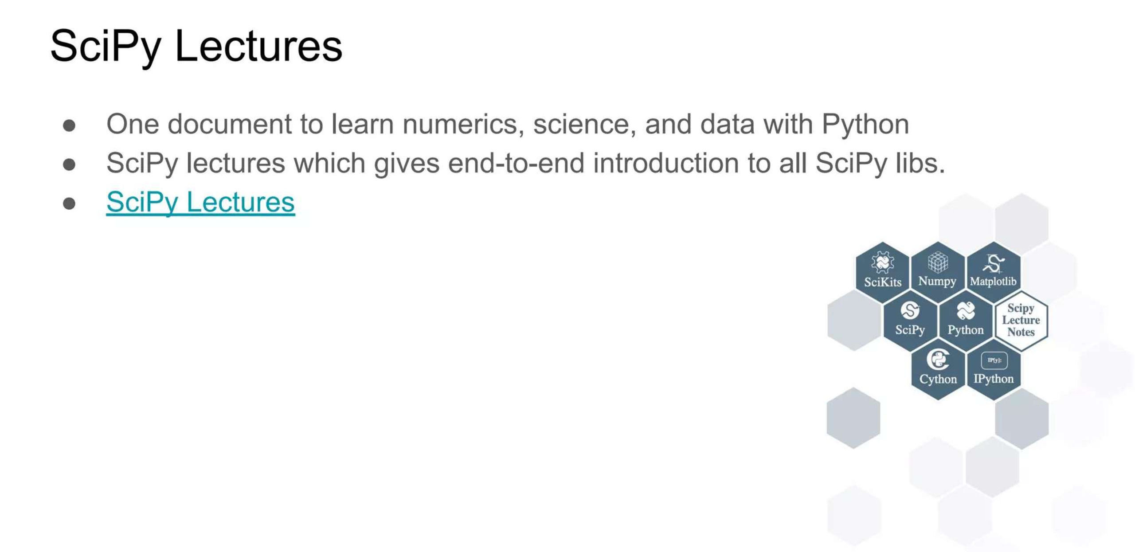
PYTHON ECO SYSTEM

Slide 30
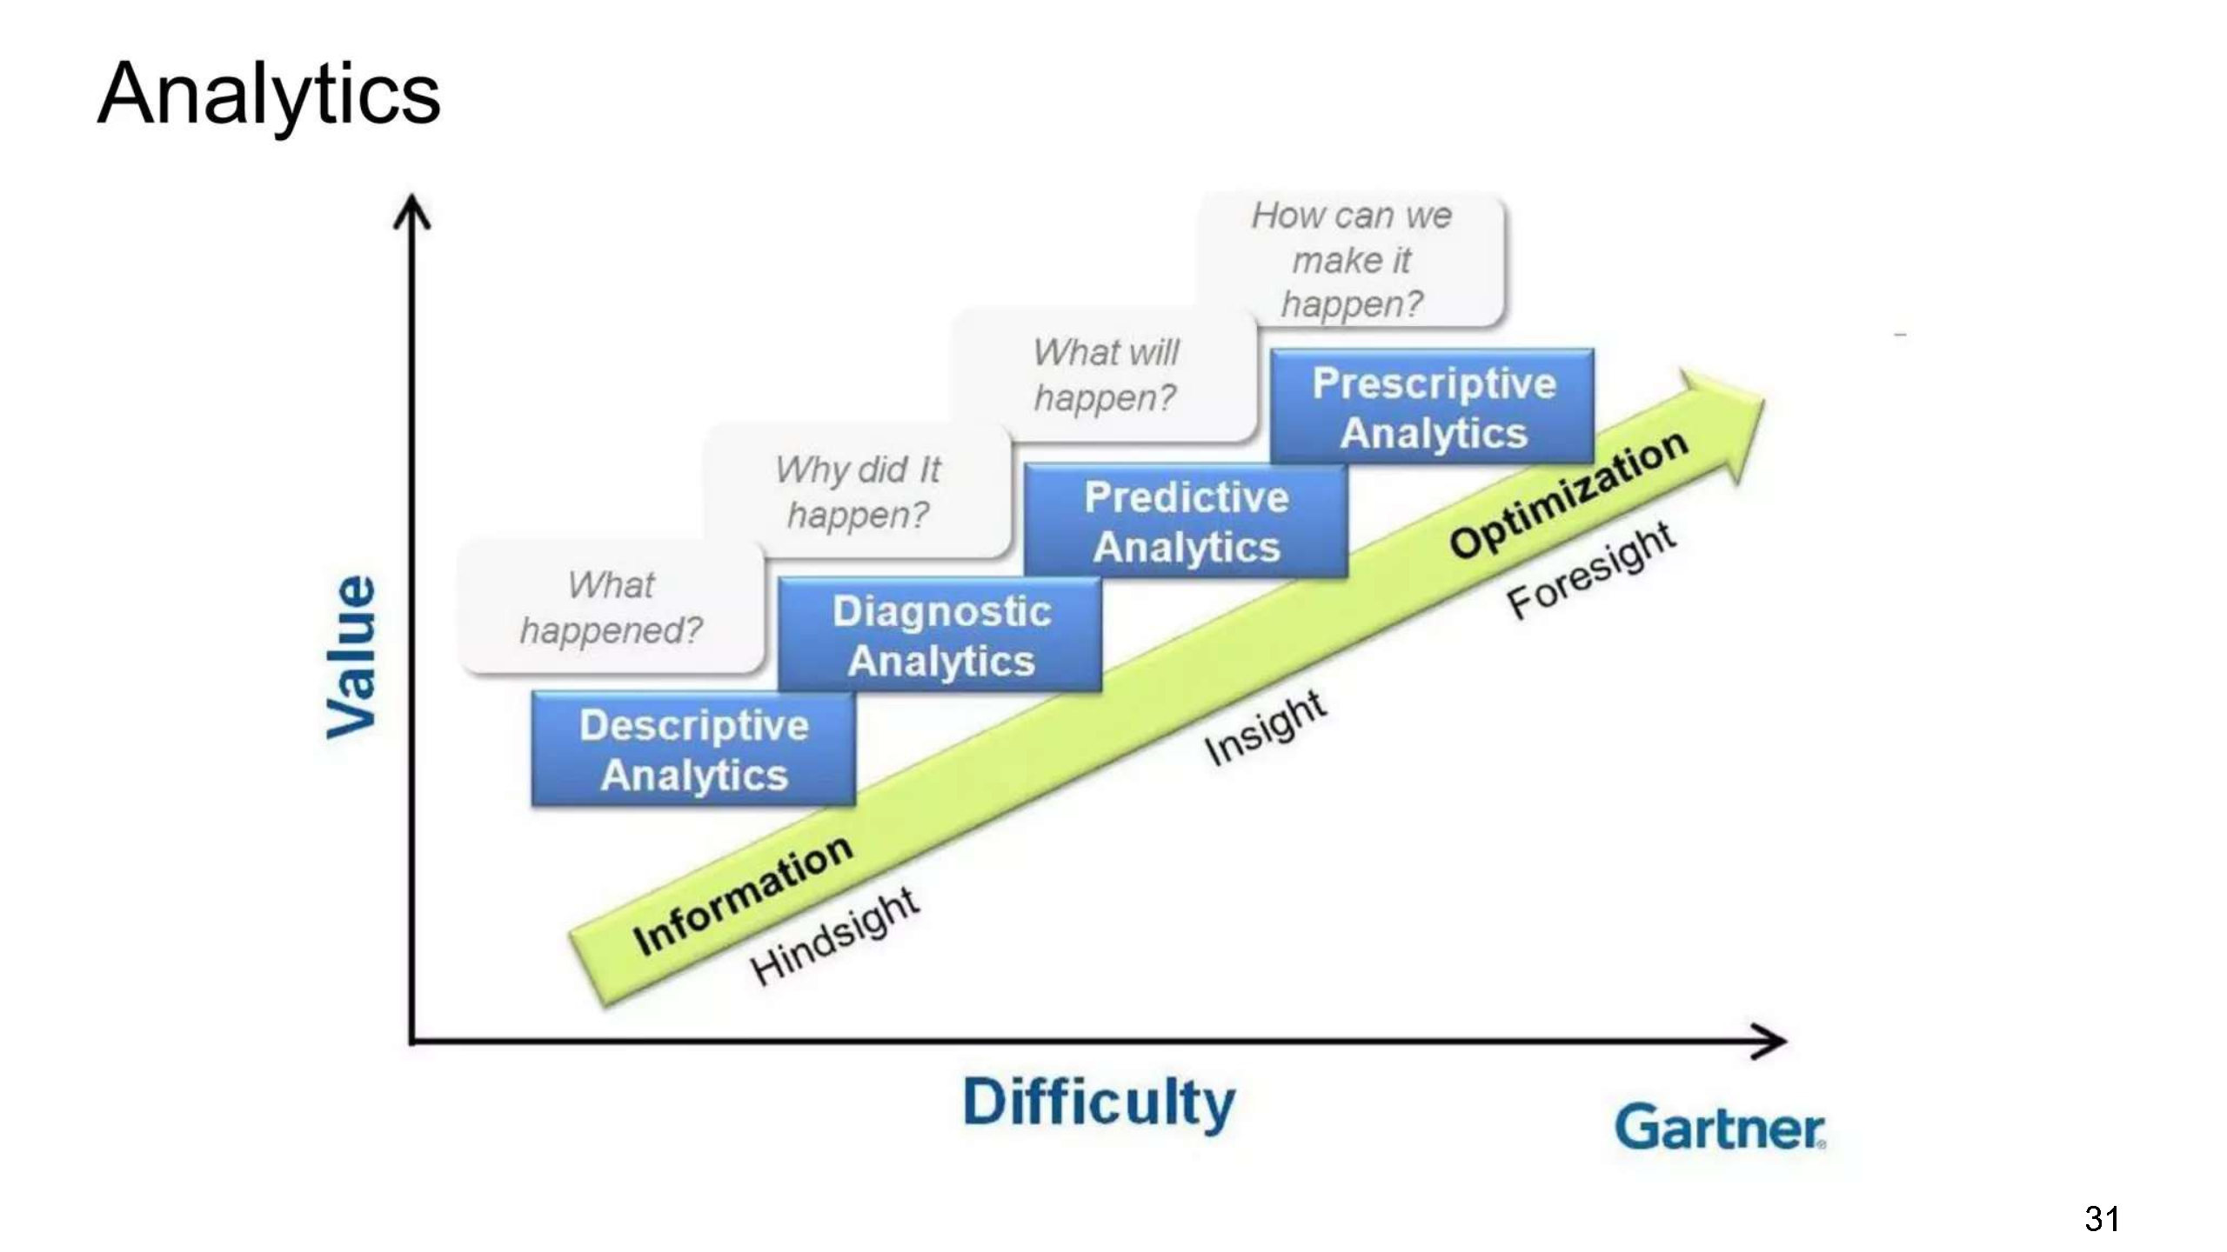
ANALYTICS

Slide 31
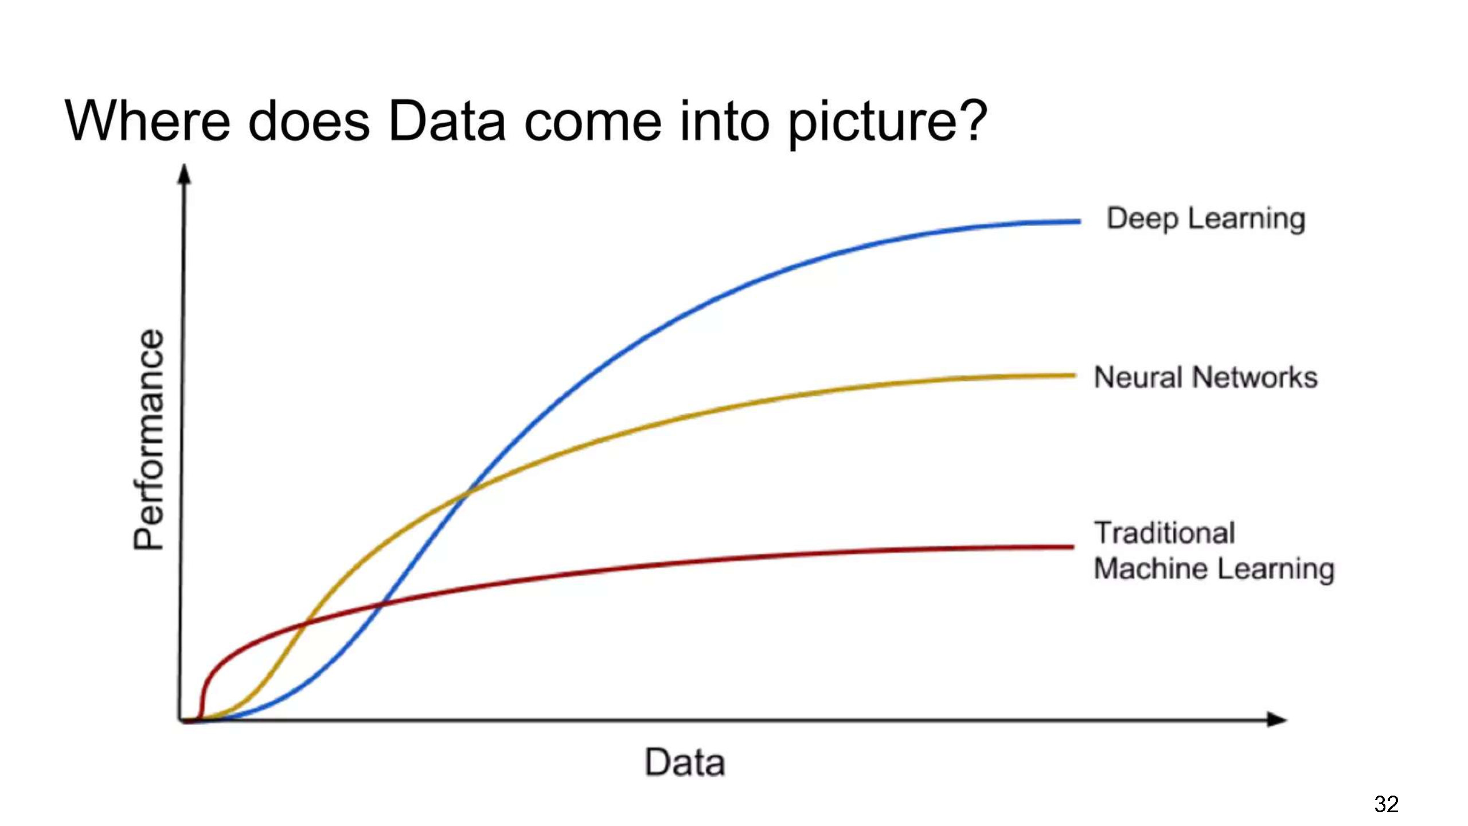
WHERE DO DATA COME INTO PICTURE?

Slide 32
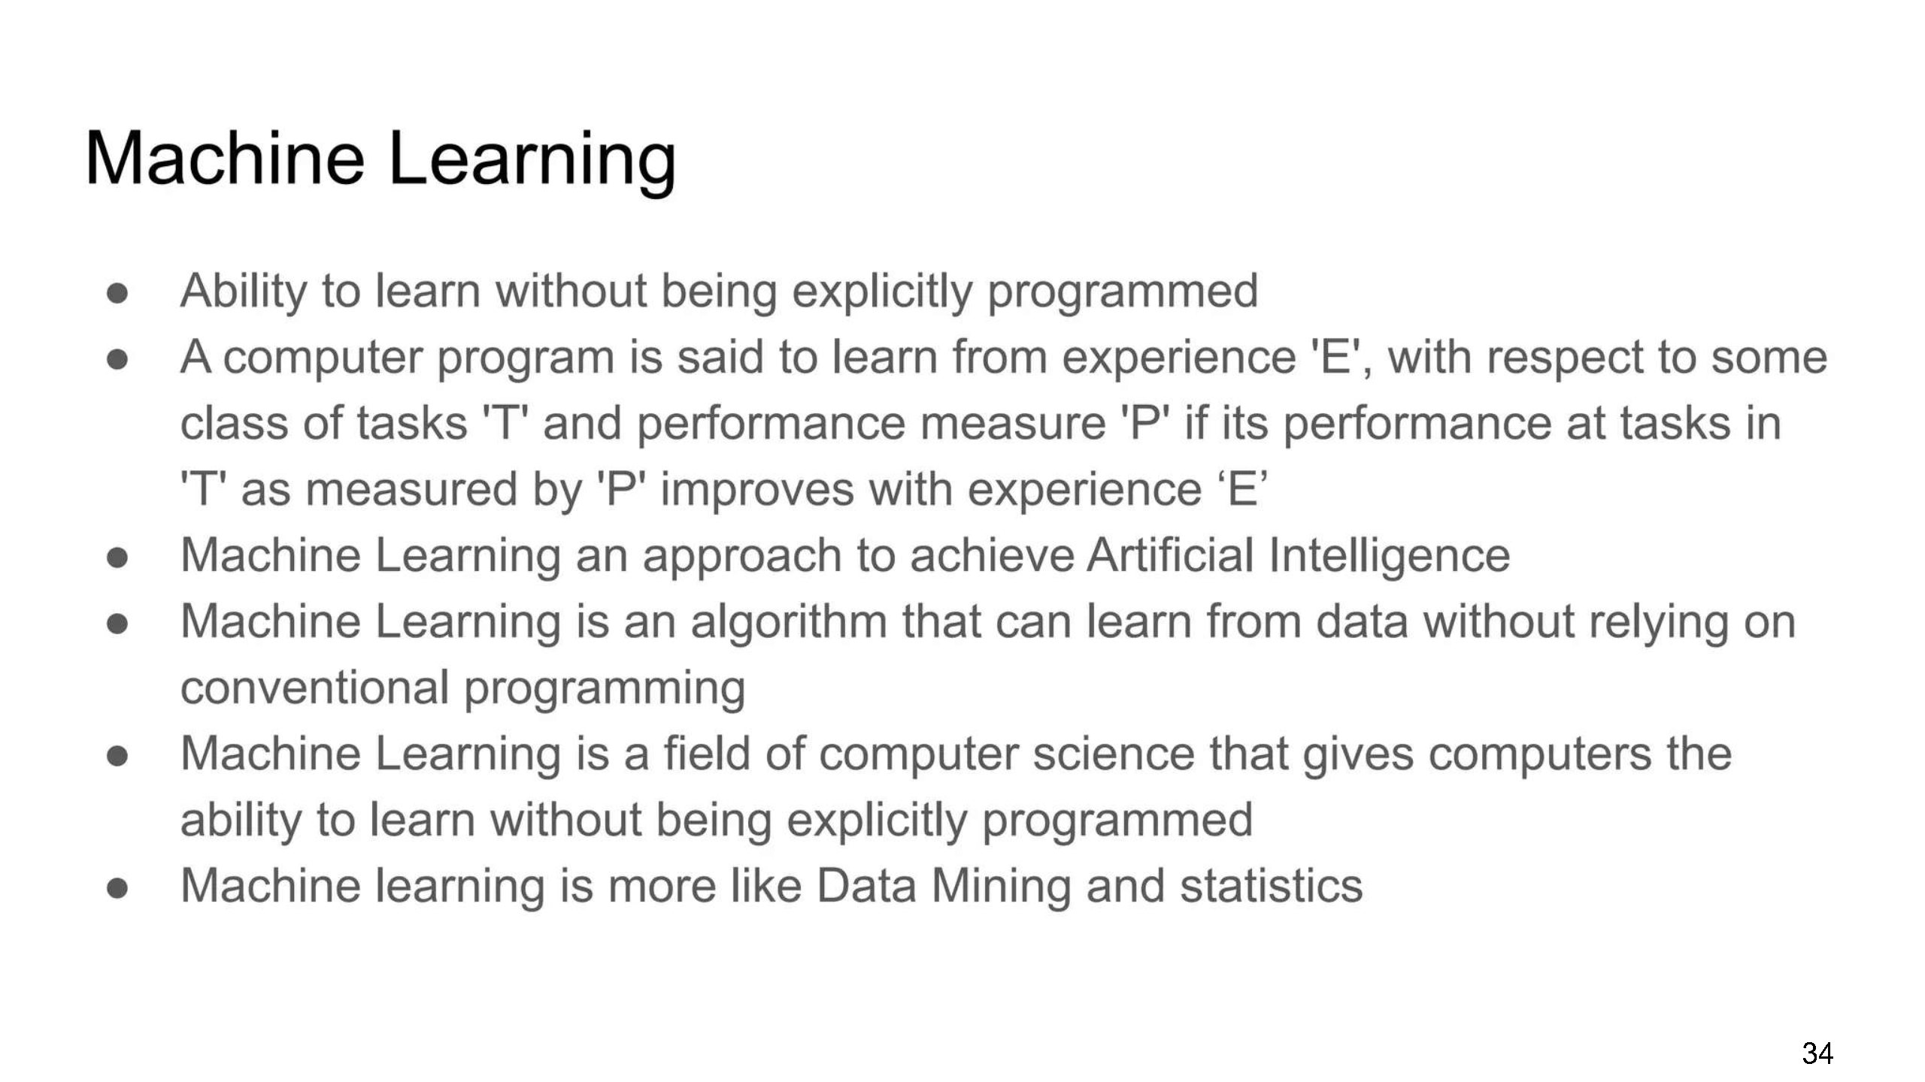
MACHINE LEARNING

Slide 33
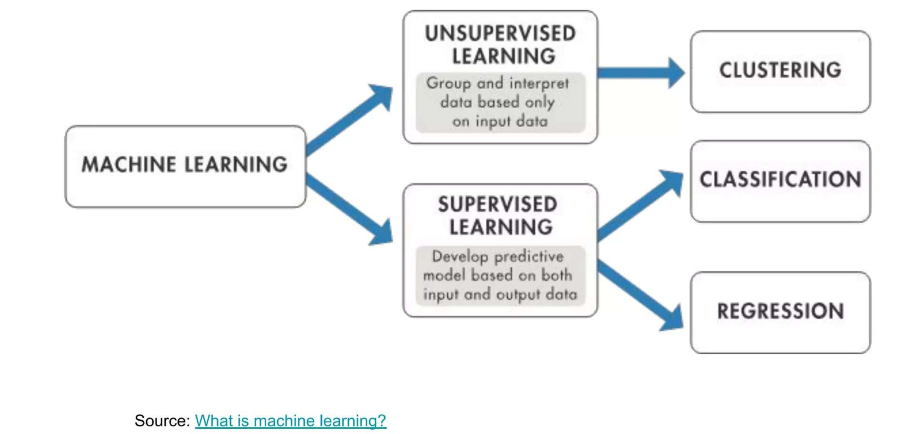
MACHINE LEARNING

Slide 34
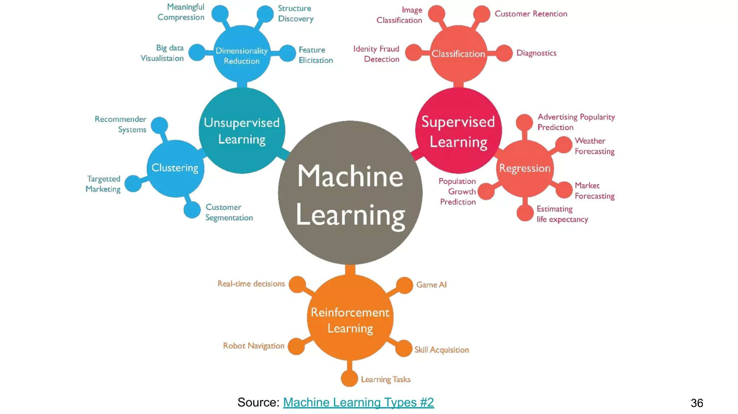
MACHINE LEARNING
Reinforcement Key Elements:
Agent
Environment
State
Reward

Slide 35
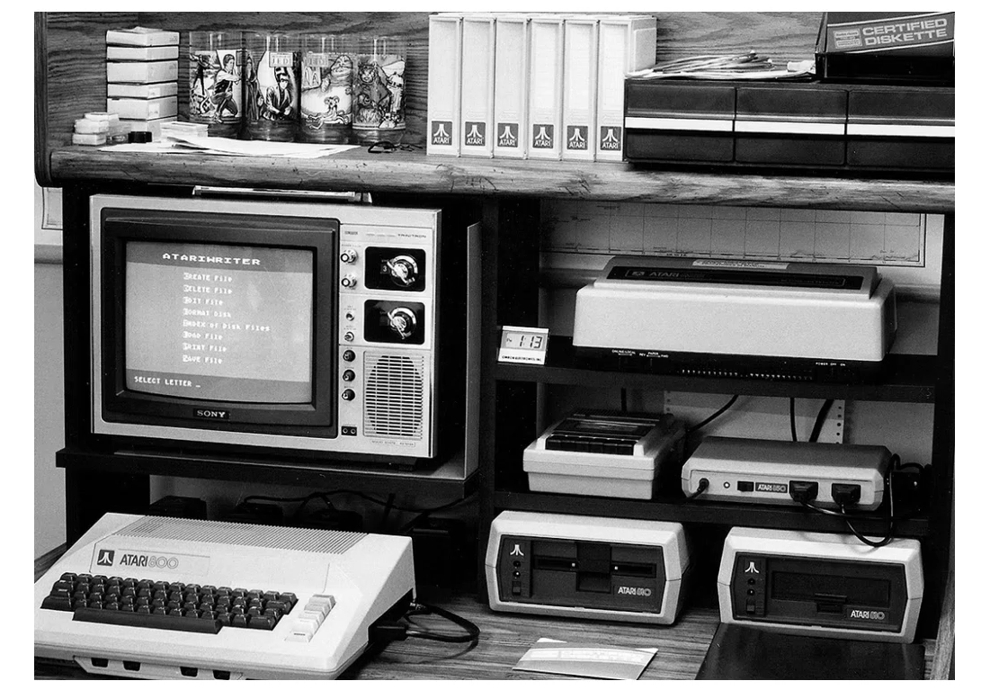
LIMITATION OF PROCESSING SYS IN 80’s & 90’s

Slide 36
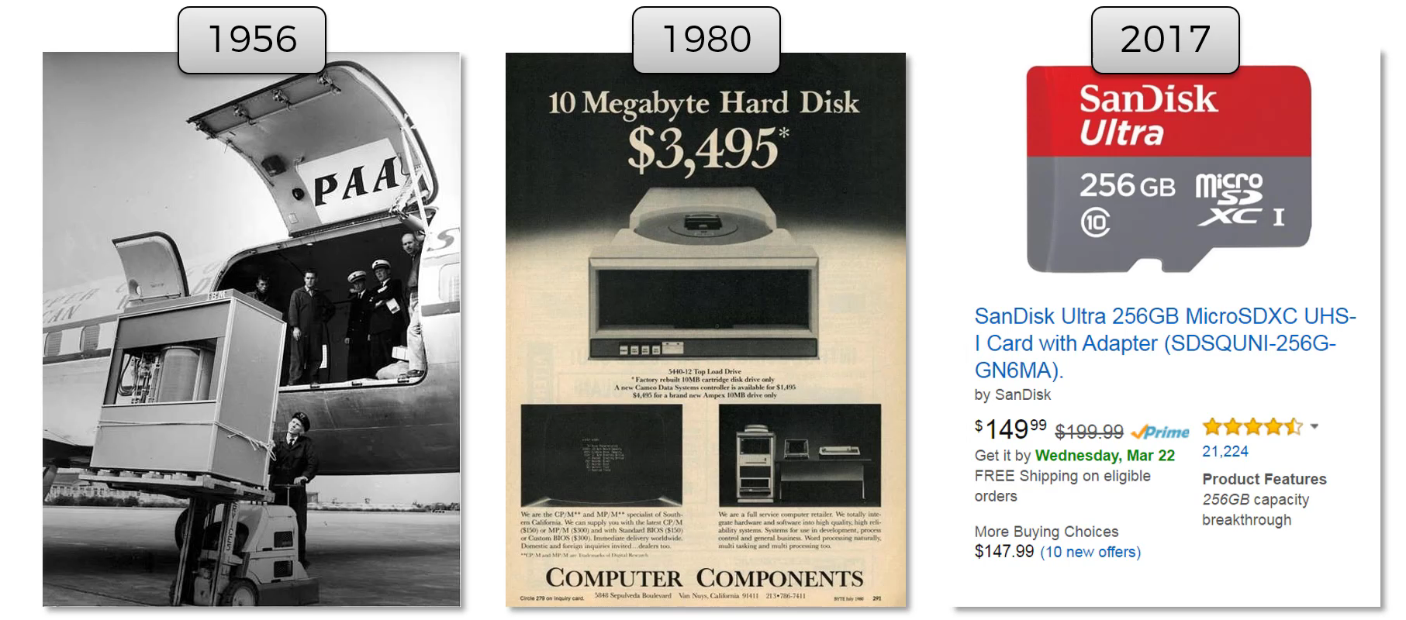
STORAGE SIZE AVAILABILITY OVER PD OF TIME

Slide 37
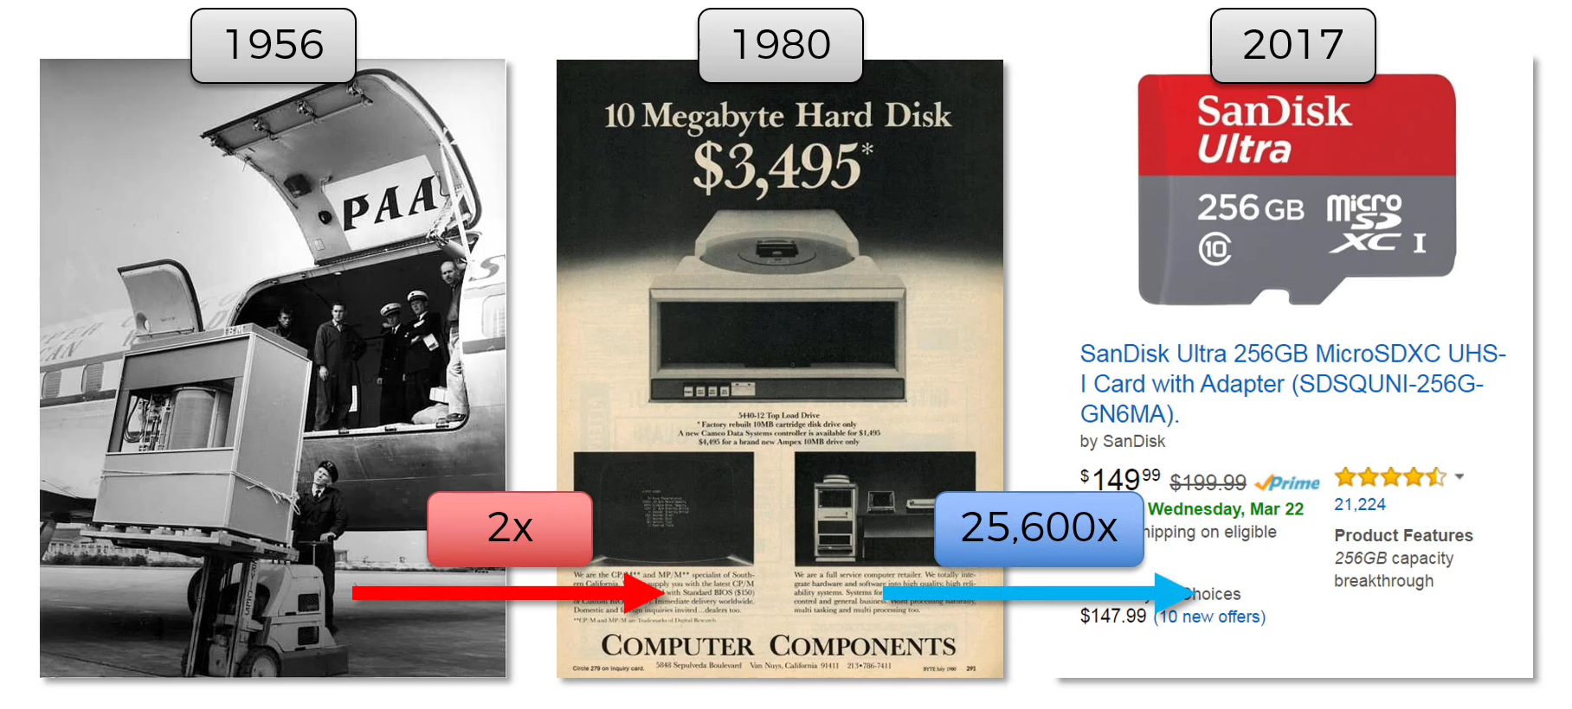
STORAGE SIZE AVAILABILITY OVER PD OF TIME

Slide 38
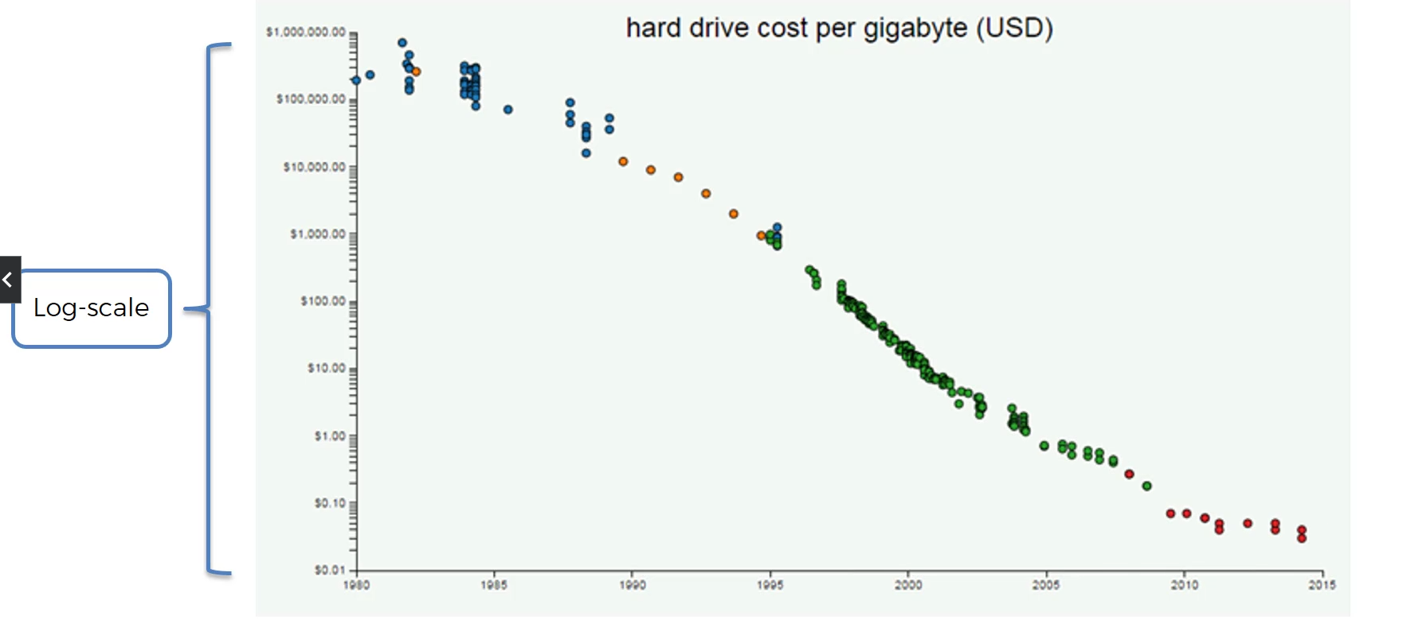
LOG DECREASE IN COST OF HARDRIVES

Slide 39

DNA STORAGE & RETRIEVAL
Approx – 2000 USD storage
& 2000 USD retrieval

Slide 40
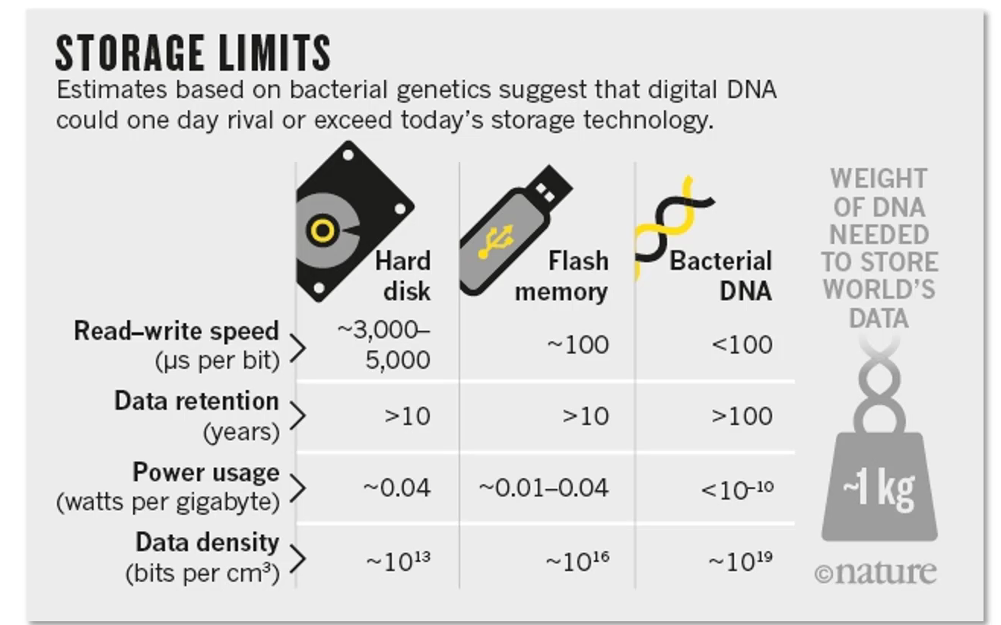
DNA STORAGE & RETRIEVAL

Slide 41
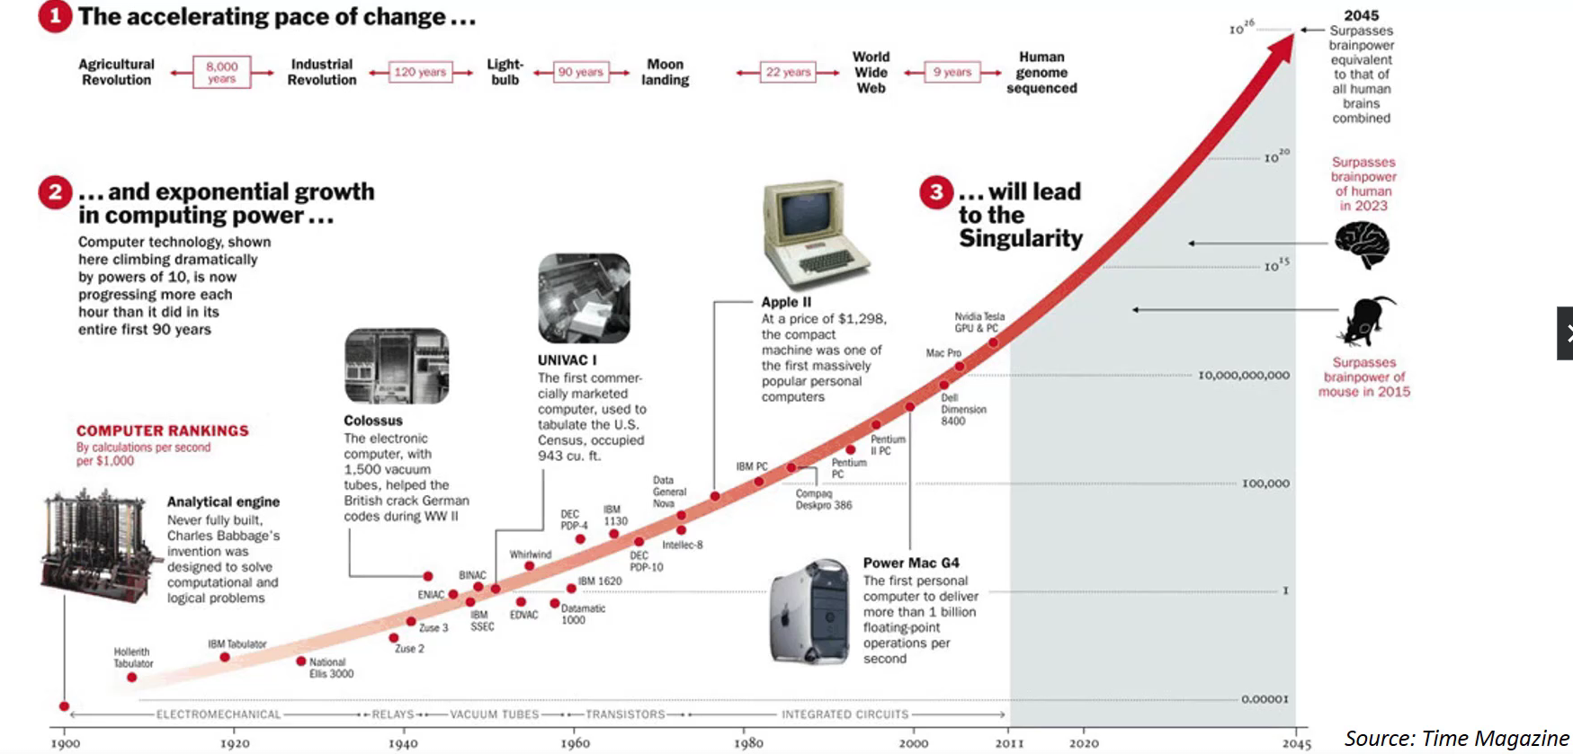
ACCELERATING PACE OF COMPUTING (MOORES LAW)

Slide 42
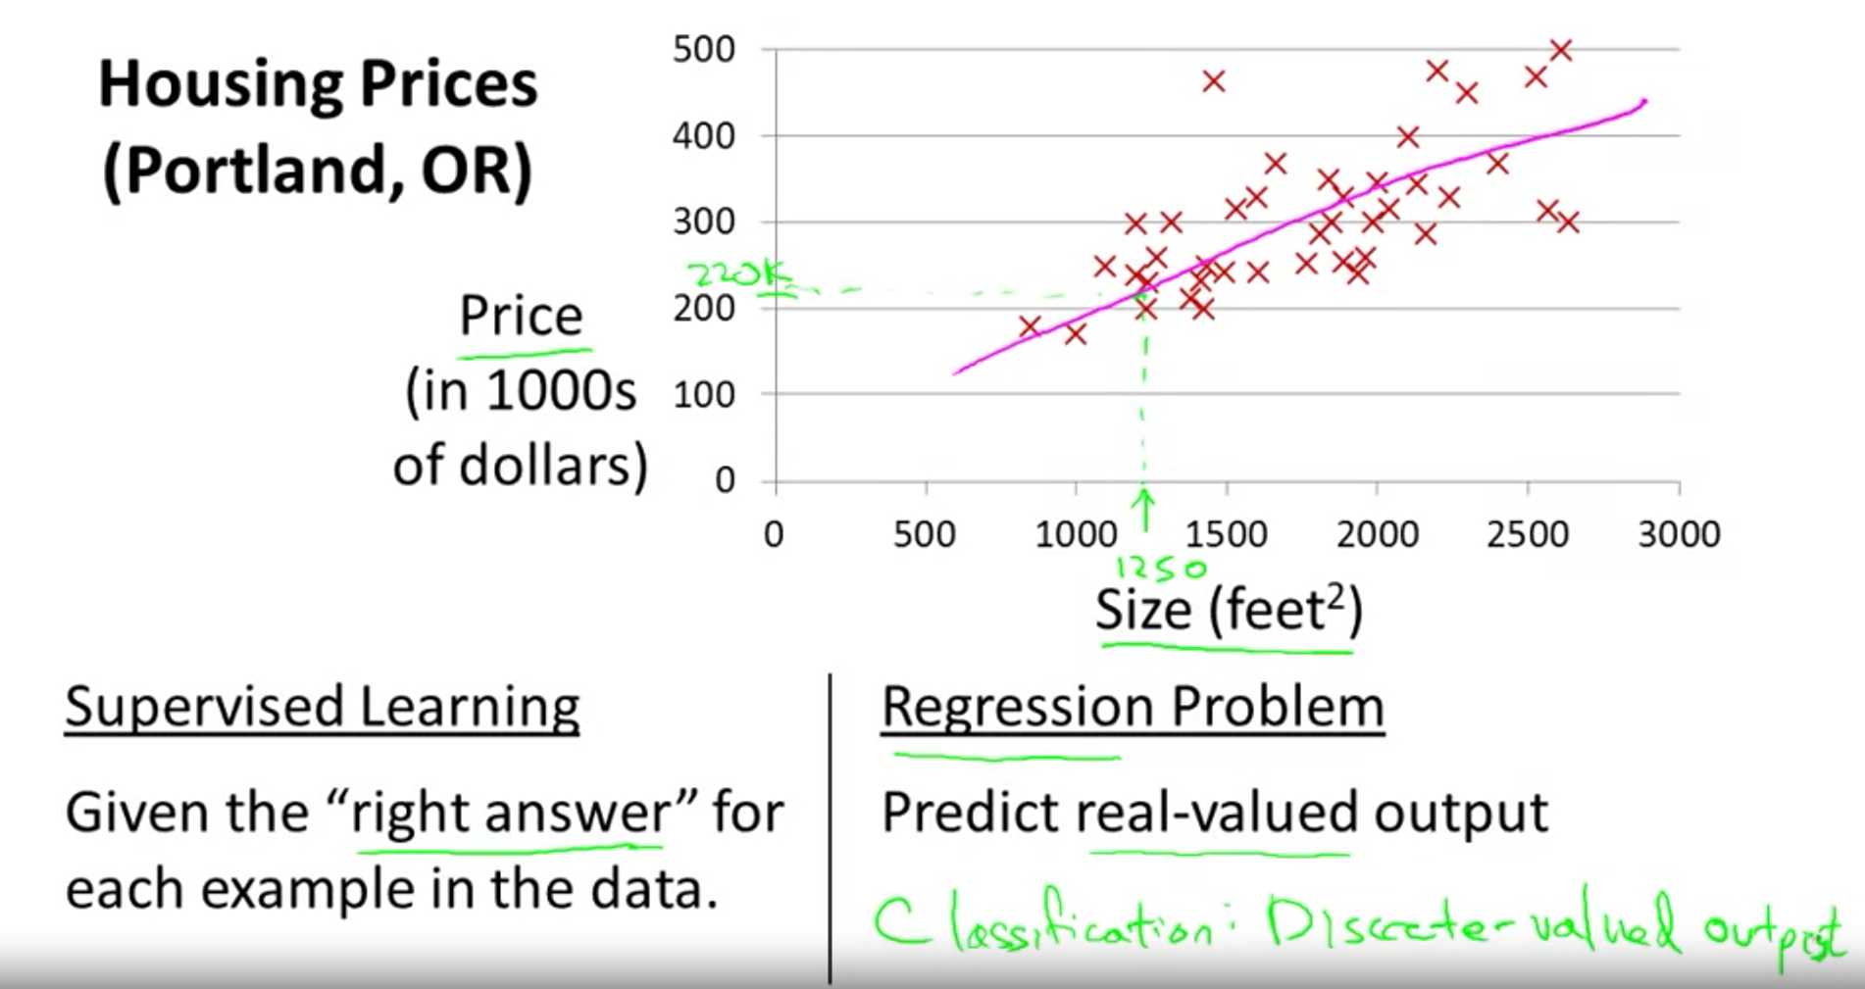
TRADITIONAL MACHINE LEARNING PROBLEM

Slide 43
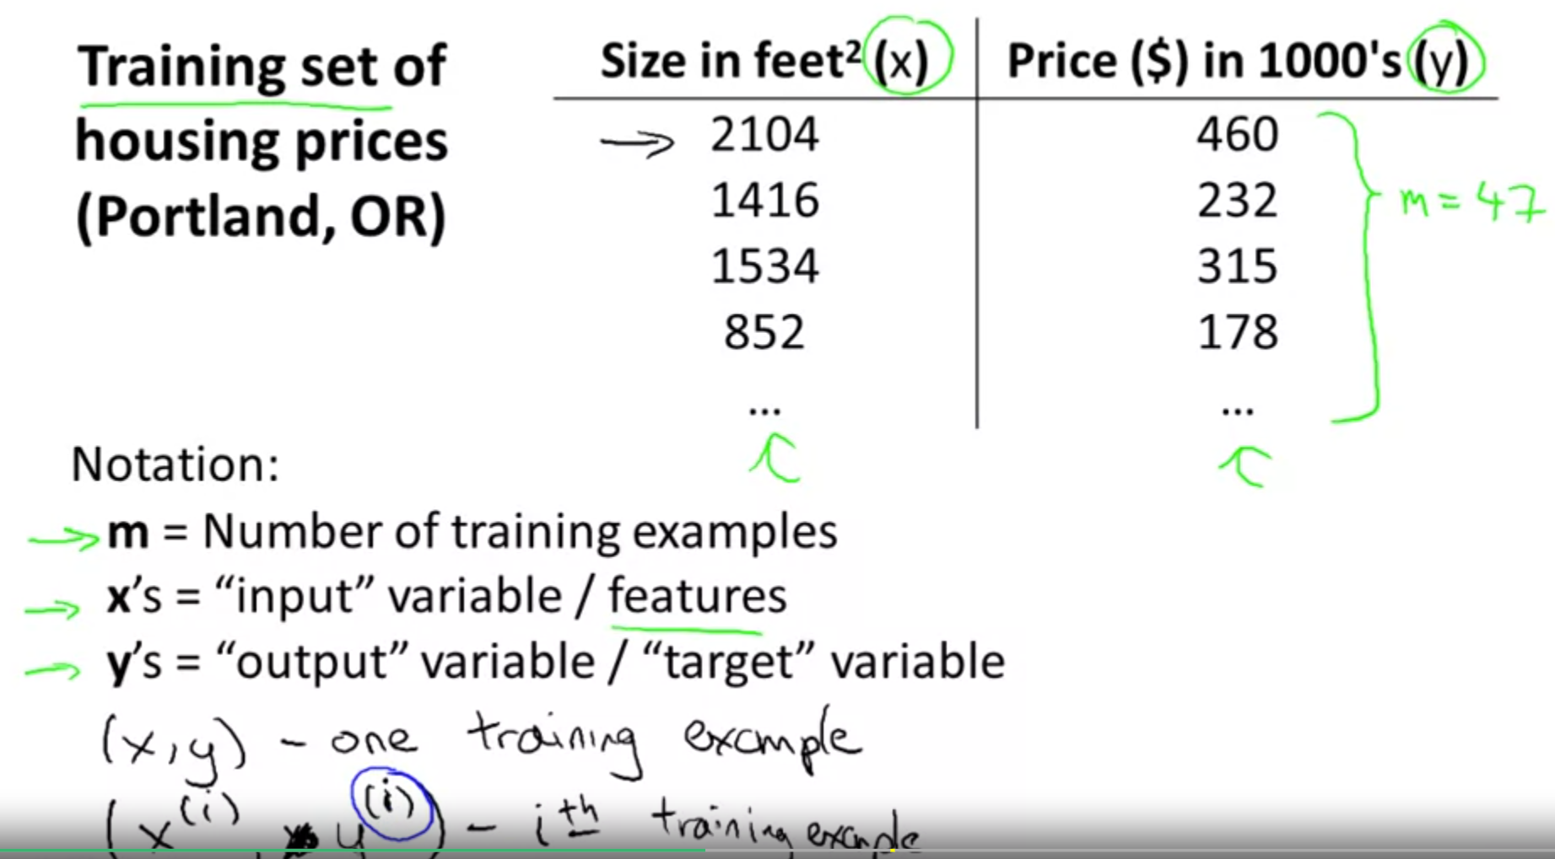
TRADITIONAL MACHINE LEARNING PROBLEM

Slide 44
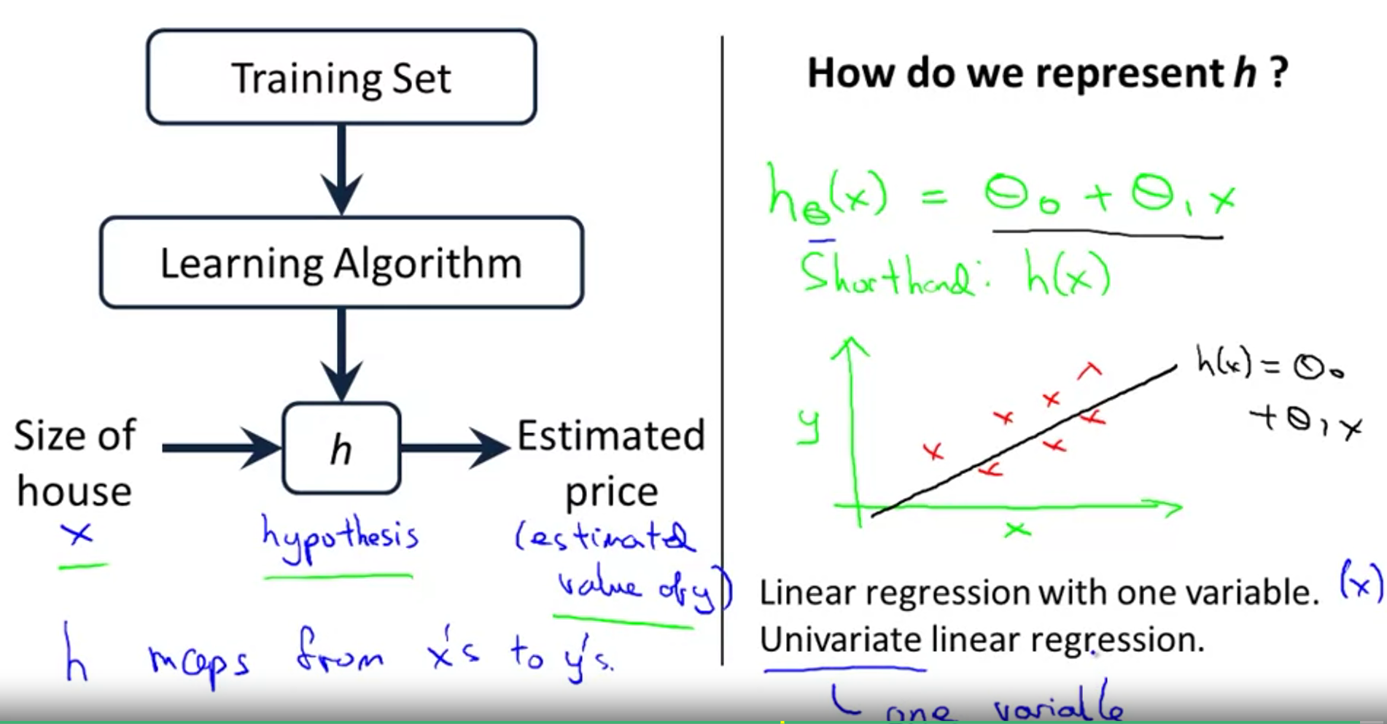
TRADITIONAL MACHINE LEARNING PROBLEM

Slide 45
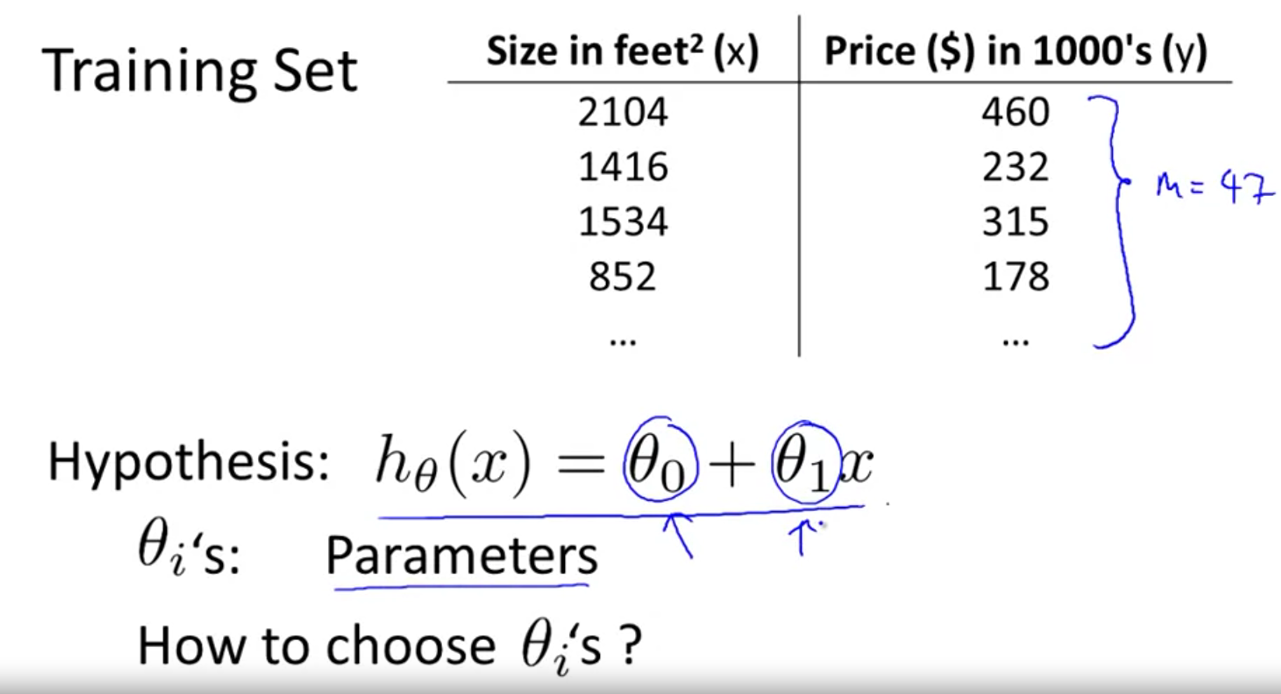
TRADITIONAL MACHINE LEARNING PROBLEM

Slide 46
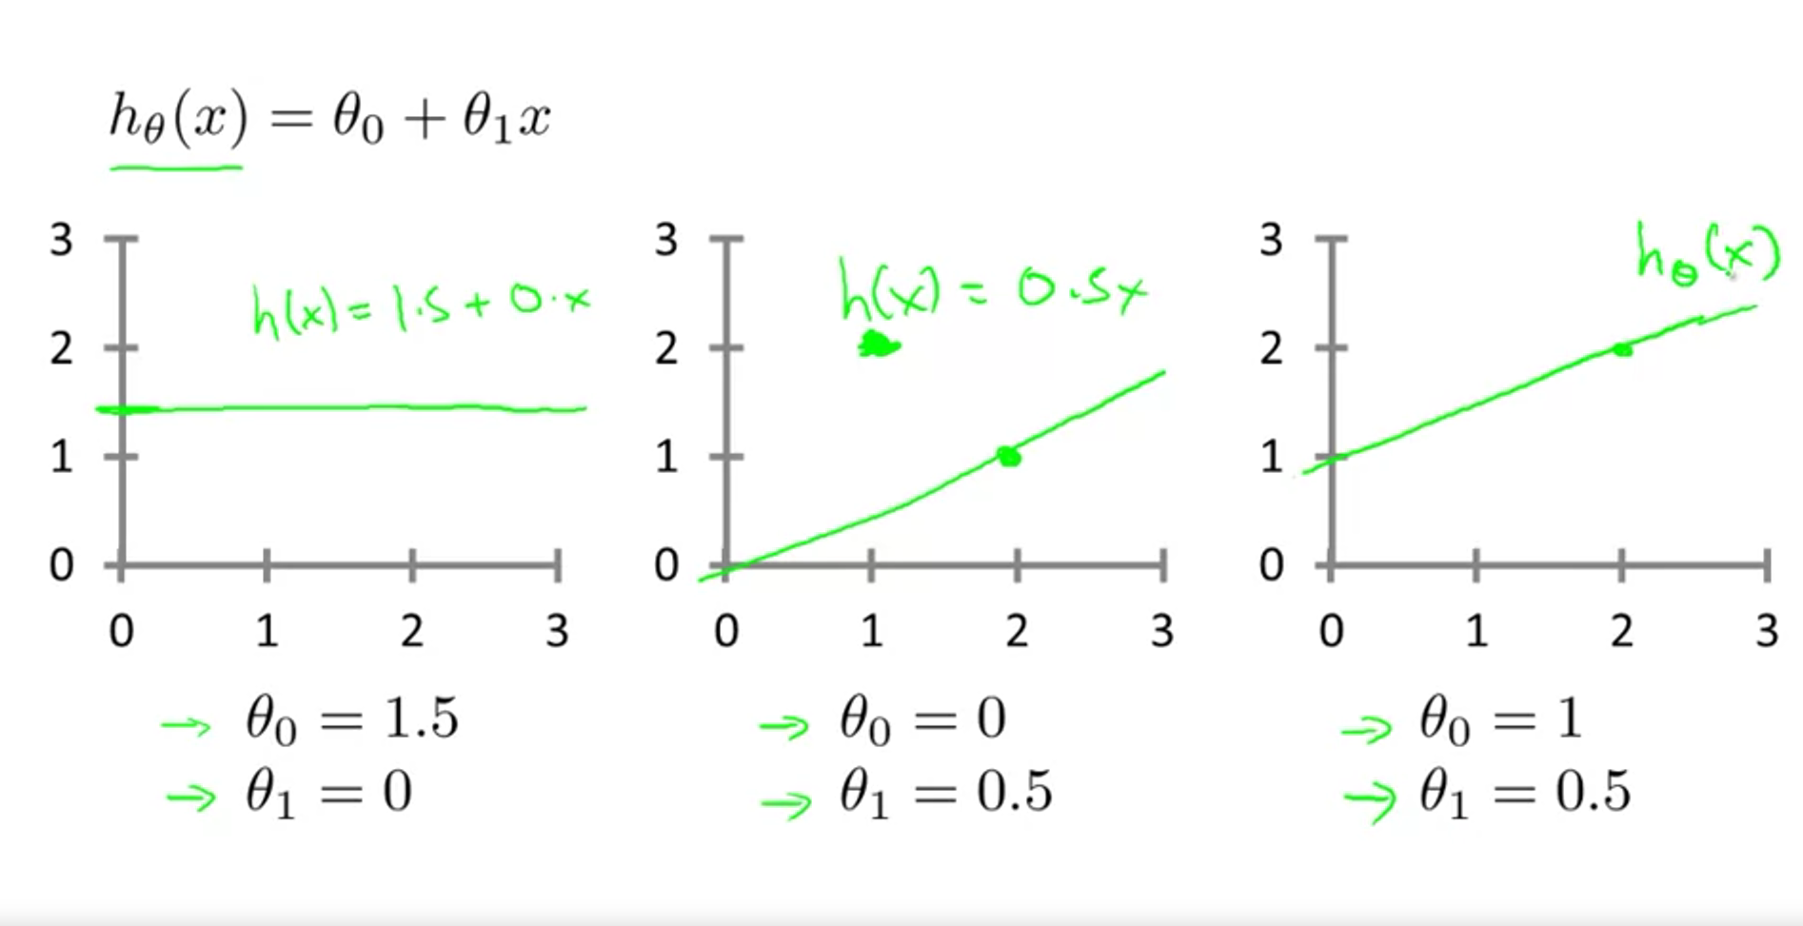
TRADITIONAL MACHINE LEARNING PROBLEM

Slide 47
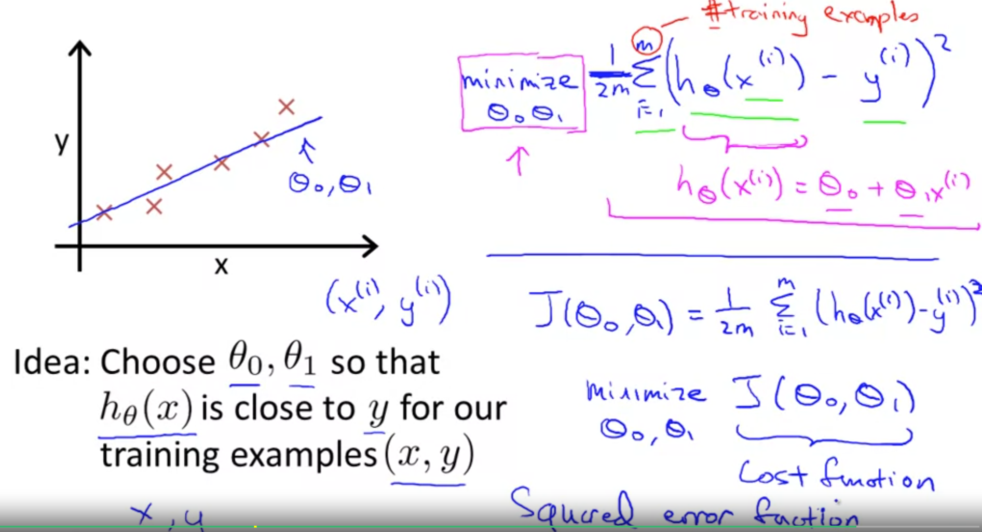
TRADITIONAL MACHINE LEARNING PROBLEM

Slide 48
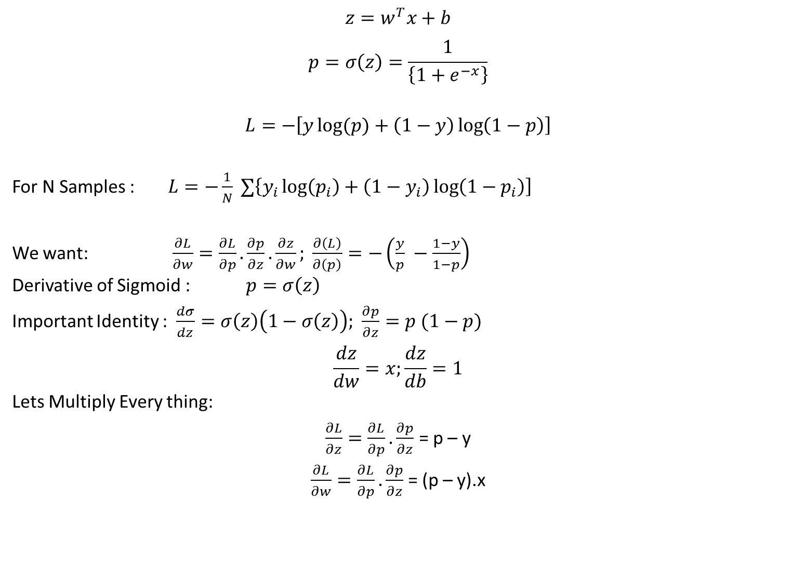
LOGISTIC REGRESSION – MACHINE LEARNING BASE LINE
$$z=w^{T}x+b$$
$$p=σ\left(z\right)=\frac{1}{\left\{1+e^{−x}\right\}}$$
$$L=−\left[y\log{(p)}+\left(1−y\right)\log\left(1−p\right)\right]$$
For N Samples : $L=−\frac{1}{N} ∑\left\{y_{i}\log\left(p_{i}\right)+\left(1−y_{i}\right)\log\left(1−p_{i}\right)\right]$
We want: $\frac{∂L}{∂w}=\frac{∂L}{∂p}.\frac{∂p}{∂z}.\frac{∂z}{∂w}; \frac{∂\left(L\right)}{∂\left(p\right)}=−\left(\frac{y}{p} −\frac{1−y}{1−p}\right)$
Derivative of Sigmoid : $p=σ\left(z\right)$
Important Identity : $\frac{dσ}{dz}=σ\left(z\right)\left(1−σ\left(z\right)\right);$ $\frac{∂p}{∂z}=p (1−p)$
$$\frac{dz}{dw}=x;\frac{dz}{db}=1$$
Lets Multiply Every thing:
$\frac{∂L}{∂z}=\frac{∂L}{∂p}.\frac{∂p}{∂z}$ = p – y
$\frac{∂L}{∂w}=\frac{∂L}{∂p}.\frac{∂p}{∂z}$ = (p – y).x
Notes:
Reinforcement learning (RL) is a type of machine learning where an agent learns to make decisions by interacting with an environment. The agent takes actions in the environment, receives feedback in the form of rewards or penalties, and uses this feedback to improve its future decisions. The goal is for the agent to learn a policy (a strategy of action selection) that maximizes the cumulative reward over time.
Key components of reinforcement learning include:
Agent: The learner or decision-maker.
Environment: The external system the agent interacts with.
State: A representation of the current situation of the environment.
Action: The set of possible moves the agent can make.
Reward: Feedback from the environment to evaluate actions (positive for good actions, negative for bad ones).
Policy: A strategy used by the agent to determine the next action based on the current state.
Value Function: A prediction of the long-term reward for a given state (or state-action pair).
Reinforcement learning is often applied in areas like robotics, game playing, autonomous driving, and recommendation systems.
4o
Example: Training an agent to play chess
Agent: The chess-playing AI.
Environment: The chess board and game rules.
State: The current configuration of the chessboard (i.e., where all the pieces are located).
Action: The possible moves the agent can make (e.g., moving a pawn, knight, or other pieces).
Reward:
Positive reward for achieving a goal (like capturing an opponent's piece or winning the game).
Negative reward for making a bad move (like losing a piece or getting checkmated).
No immediate reward for intermediate moves, but the final result (win, lose, or draw) greatly impacts cumulative rewards.
Policy: The strategy the agent uses to decide which move to make based on the current state of the board.
Training Process:
The agent starts by playing games randomly, making random moves. It learns from each game's outcome (win or loss).
After many games, it starts to identify patterns of moves that lead to better outcomes, adjusting its actions to maximize the chances of winning.
Over time, it improves its policy by optimizing moves based on long-term rewards, learning the value of board positions and actions that will increase the probability of victory.
Example in Action:
Initial game: The agent might sacrifice a valuable piece like a queen early in the game and lose.
Learning: Over many games, it realizes that preserving the queen increases its chances of winning in the long run.
Improvement: The agent now avoids unnecessary sacrifices and plays more strategically to improve its performance.
This is how reinforcement learning allows an agent to progressively learn an optimal strategy through trial and error by maximizing rewards and minimizing penalties over time.

Slide 49
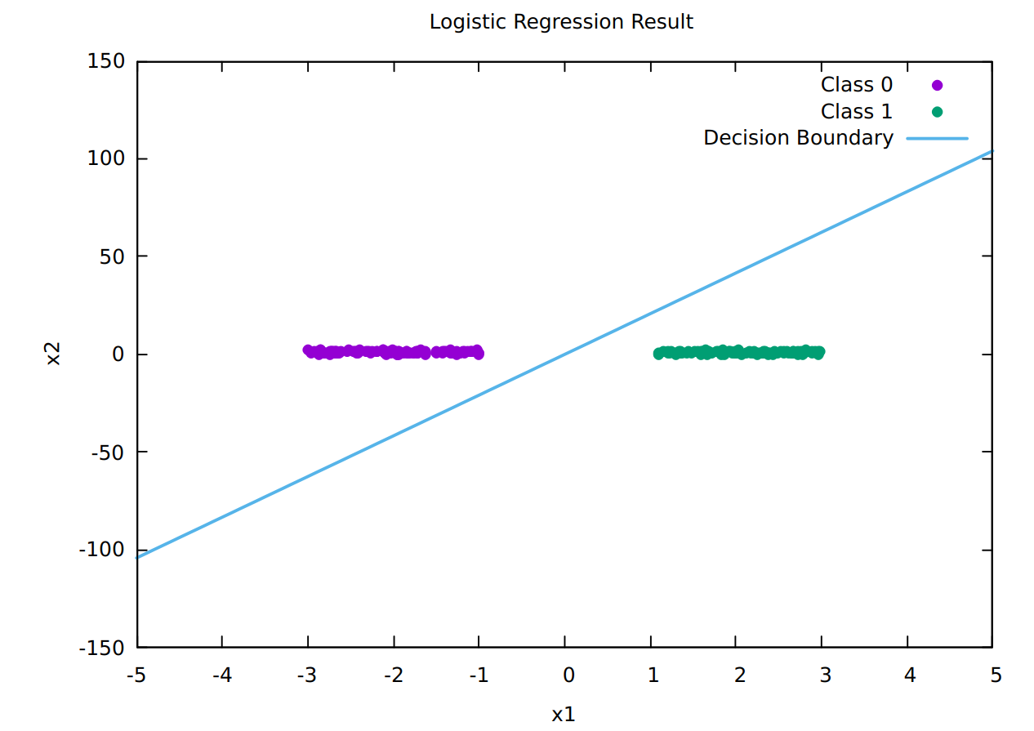
LOGISTIC REGRESSION RESULTS
Notes:
Reinforcement learning (RL) is a type of machine learning where an agent learns to make decisions by interacting with an environment. The agent takes actions in the environment, receives feedback in the form of rewards or penalties, and uses this feedback to improve its future decisions. The goal is for the agent to learn a policy (a strategy of action selection) that maximizes the cumulative reward over time.
Key components of reinforcement learning include:
Agent: The learner or decision-maker.
Environment: The external system the agent interacts with.
State: A representation of the current situation of the environment.
Action: The set of possible moves the agent can make.
Reward: Feedback from the environment to evaluate actions (positive for good actions, negative for bad ones).
Policy: A strategy used by the agent to determine the next action based on the current state.
Value Function: A prediction of the long-term reward for a given state (or state-action pair).
Reinforcement learning is often applied in areas like robotics, game playing, autonomous driving, and recommendation systems.
4o
Example: Training an agent to play chess
Agent: The chess-playing AI.
Environment: The chess board and game rules.
State: The current configuration of the chessboard (i.e., where all the pieces are located).
Action: The possible moves the agent can make (e.g., moving a pawn, knight, or other pieces).
Reward:
Positive reward for achieving a goal (like capturing an opponent's piece or winning the game).
Negative reward for making a bad move (like losing a piece or getting checkmated).
No immediate reward for intermediate moves, but the final result (win, lose, or draw) greatly impacts cumulative rewards.
Policy: The strategy the agent uses to decide which move to make based on the current state of the board.
Training Process:
The agent starts by playing games randomly, making random moves. It learns from each game's outcome (win or loss).
After many games, it starts to identify patterns of moves that lead to better outcomes, adjusting its actions to maximize the chances of winning.
Over time, it improves its policy by optimizing moves based on long-term rewards, learning the value of board positions and actions that will increase the probability of victory.
Example in Action:
Initial game: The agent might sacrifice a valuable piece like a queen early in the game and lose.
Learning: Over many games, it realizes that preserving the queen increases its chances of winning in the long run.
Improvement: The agent now avoids unnecessary sacrifices and plays more strategically to improve its performance.
This is how reinforcement learning allows an agent to progressively learn an optimal strategy through trial and error by maximizing rewards and minimizing penalties over time.

